Slide 1
‘Ruin the landscape, spoil the view’

Slide 2
Scenic Summits

Slide 3
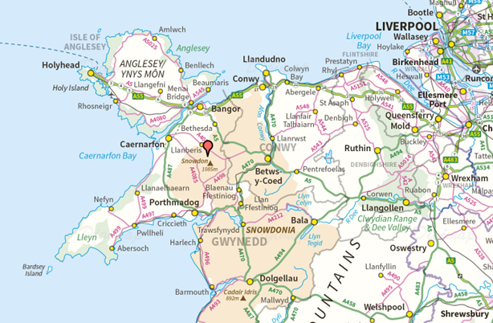
Location of Snowdon

Slide 4
Snowdon OS Landranger 1:50 000

Slide 5
Snowdon OS Explorer 1:25 000

Slide 6
Snowdon 1:10 000

Slide 7
Snowdon
© Copyright Eirian Evans, www.geograph.org.uk

Slide 8
Snowdon
© Copyright Mike Quinn, www.geography.org.uk

Slide 9
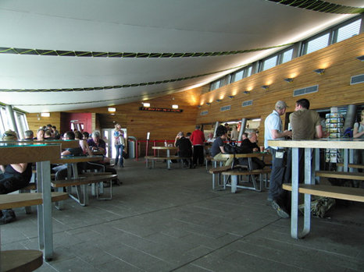
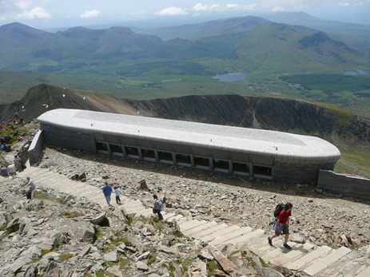
Snowdon café and visitor centre
© Copyright Dave Croker, www.geography.org.uk
© Copyright Colin Park, www.geography.org.uk

Slide 10
Location of Cheddar Gorge

Slide 11
Cheddar Gorge OS Explorer 1:25 000

Slide 12
Cheddar Gorge

Slide 13
Cheddar Gorge cable car proposal

Slide 14
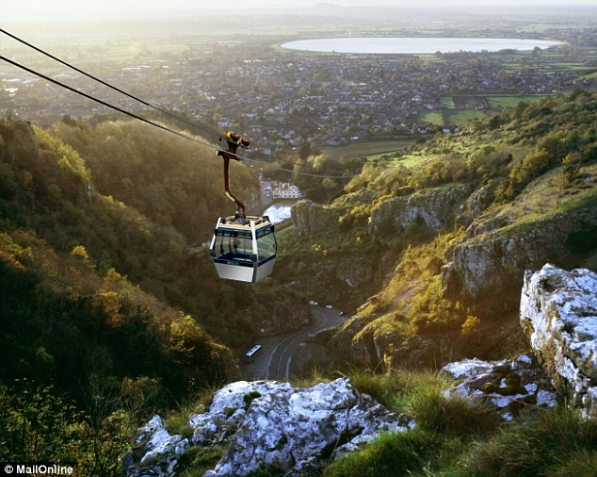
Cheddar Gorge cable car – simulation

Slide 15
Location of Moor’s Valley next to New Forest

