Slide 1

Ideas for #Homeschooling with Digimap for Schools
Peter O’ Hare
Services and User Engagement
EDINA

Slide 2
Introduction to Digimap for Schools
Online resource
Contemporary and historical maps and aerial photography for all of GB
Web based
Pc, laptops, smartboards, tablets
Single username/password
Save and export work
Print
Homework

Slide 3
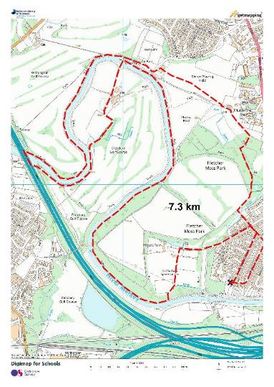
Activity 1:
One walk per day: Make the most of it!
Plan your route
Measure your distance
Document your route (take photos of human and physical features)

Slide 4
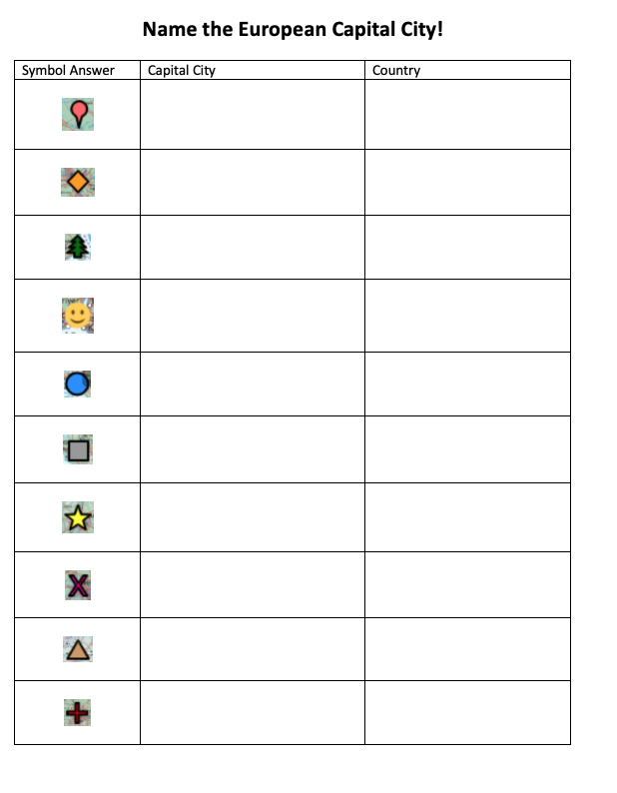
Activity 2: Find the City:
Easily adaptable for any city.
Once you have created a map its just a matter of changing the locations of each symbol to create a new exercise

Slide 5
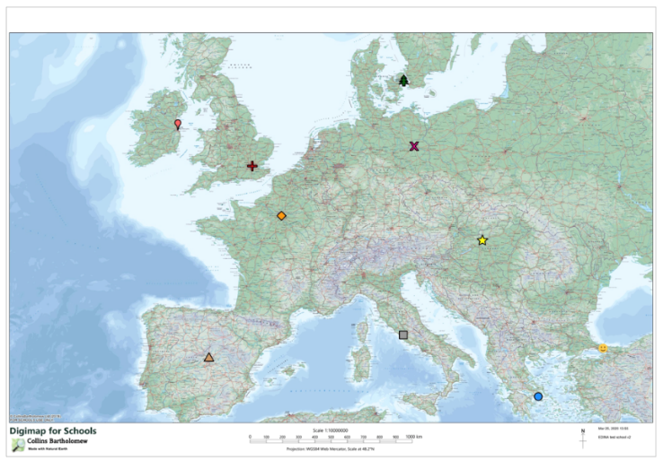

Slide 6
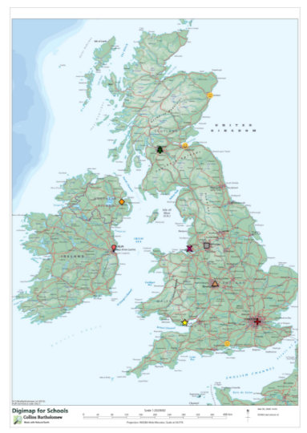
Great Britain Towns and Cities:

Slide 7




Activity 3: Treasure Hunt-
Using OS Map symbol flash cards
https://www.ordnancesurvey.co.uk/documents/resources/25k-map-symbol-flashcards.pdf
Or google: Ordnance Survey Map symbol flash cards

Slide 9
Activity 4: Capital Cities Game:
https://random.country/capital?
Youtube video of the game here
https://www.youtube.com/watch?v=7t0Rf-UdDRs
City | Country | Distance from Pin
Port of Spain | Trinidad and Tabago | 1112
Nuuk | Greenland | 982
Andorra la Vella | Andorra | 47
Lisbon | Portugal | 100
Cairo | Egypt | 56
 | Total | 2338

Slide 10
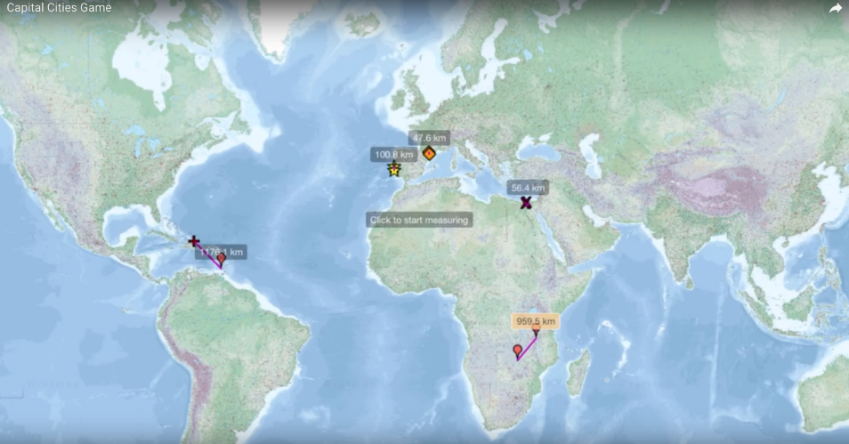

Slide 11
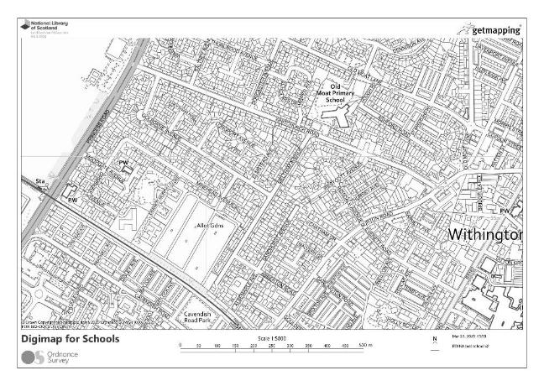
Activity 5: Land Use
Can be done within Digimap with Drawing Tools or by printing and colouring in.
Create a key:
Public buildings
Medical buildings
Council buildings
Offices
Shops
Residential

Slide 12
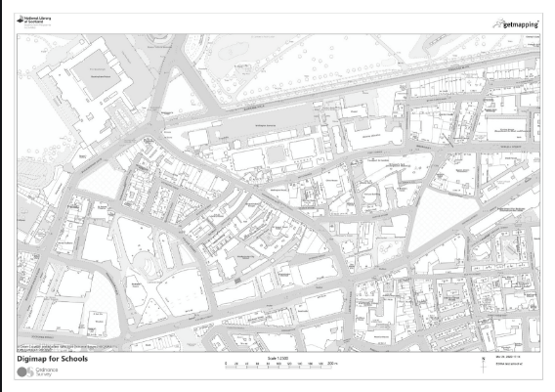
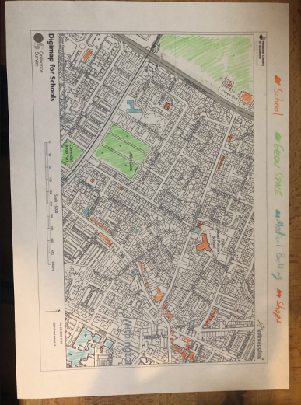

Slide 13
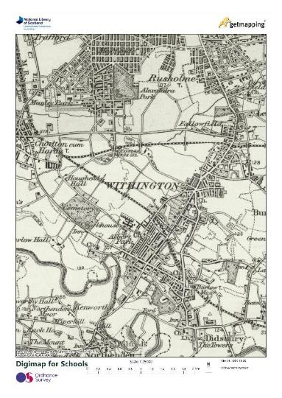
Activity 6: Spot the difference?
What has changed in your area?
Was your house there in the 1890’s or 1950’s?
Find all the things that have changed?
Why have things changed?

Slide 14
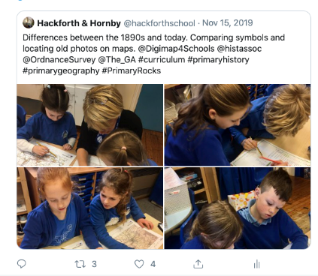
Activity 7: Urban Expansion
Look at your town or village in the 1890’s
Measure the changes from then to now, using the measurement tools.

Slide 15
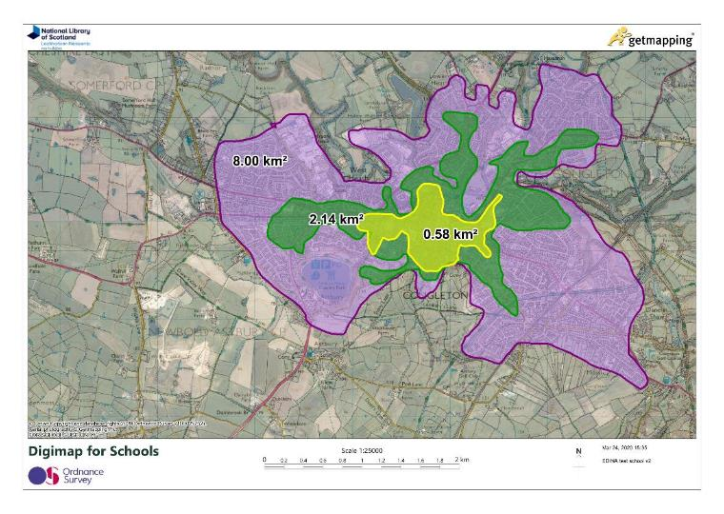

Slide 16
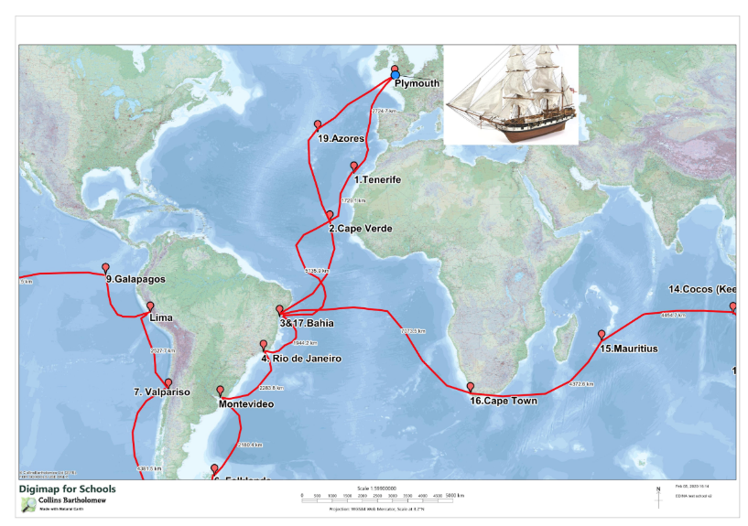
Activity 8: Story Maps

Slide 17
Home Schooling resources:
https://digimapforschools.edina.ac.uk/resources/scavengerhunt/
Youtube:
https://www.youtube.com/user/digimapforschools
Twitter:
https://twitter.com/Digimap4Schools

