Slide 1
Digimap for Schools – Mapiau Dirgel

Slide 2
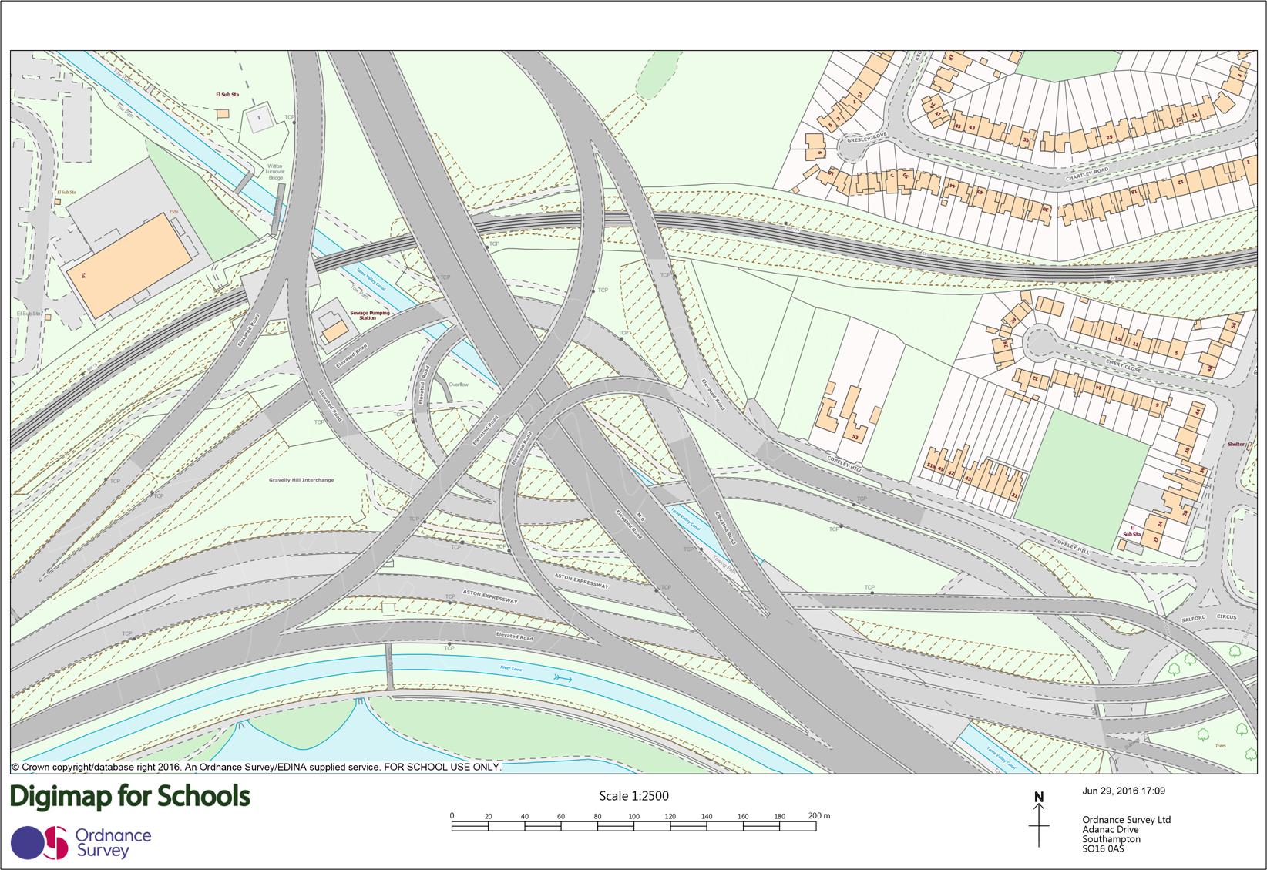
Map 1

Slide 3
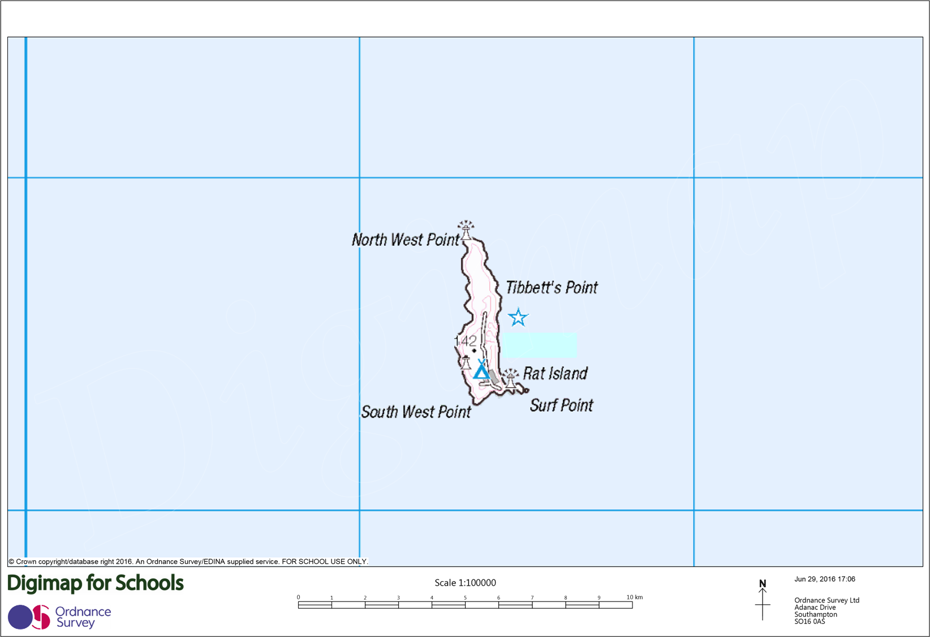
Map 2

Slide 4
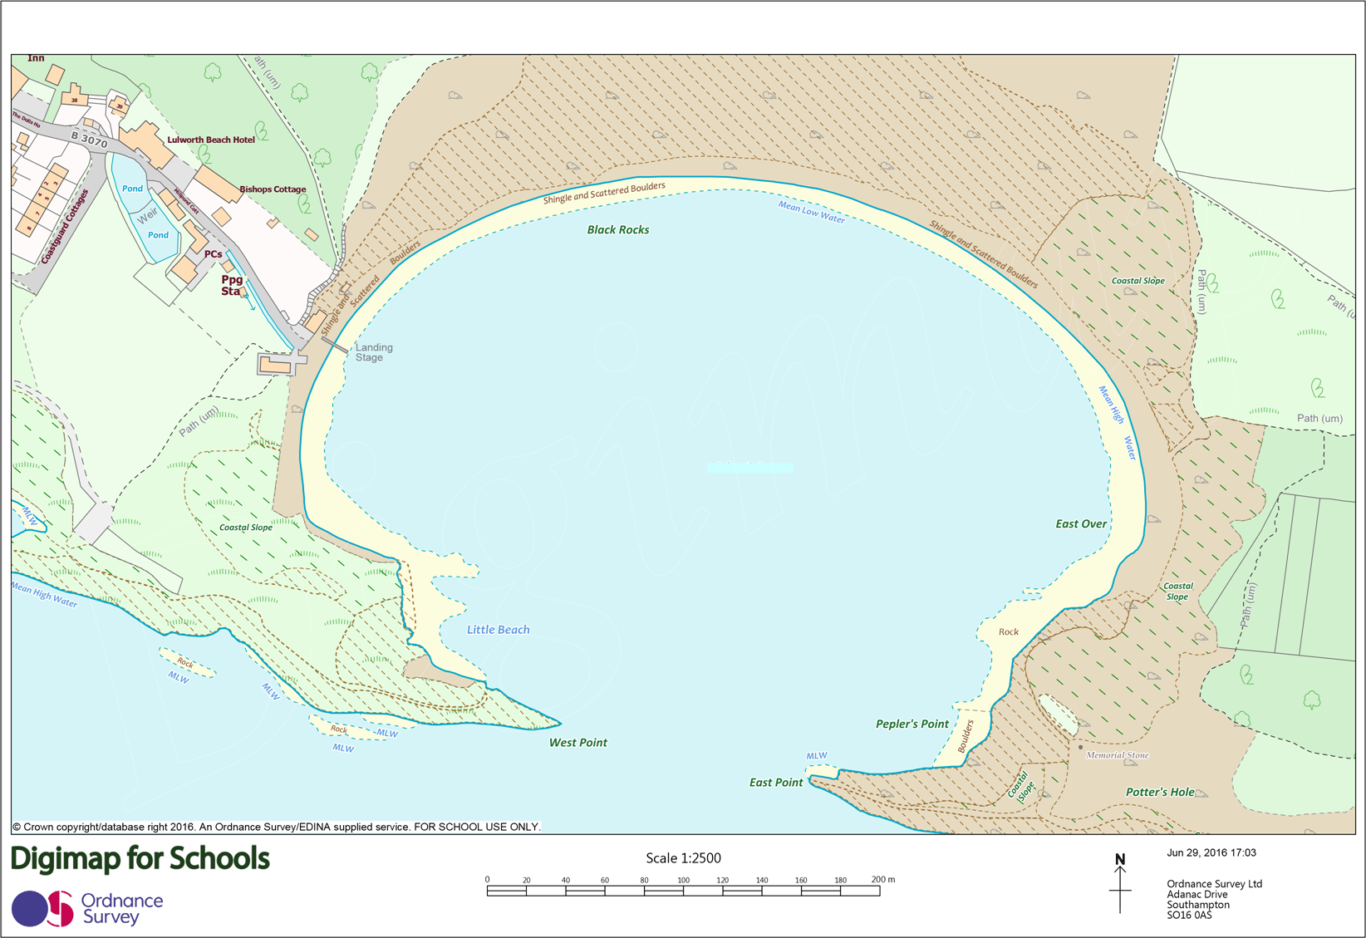
Map 3

Slide 5
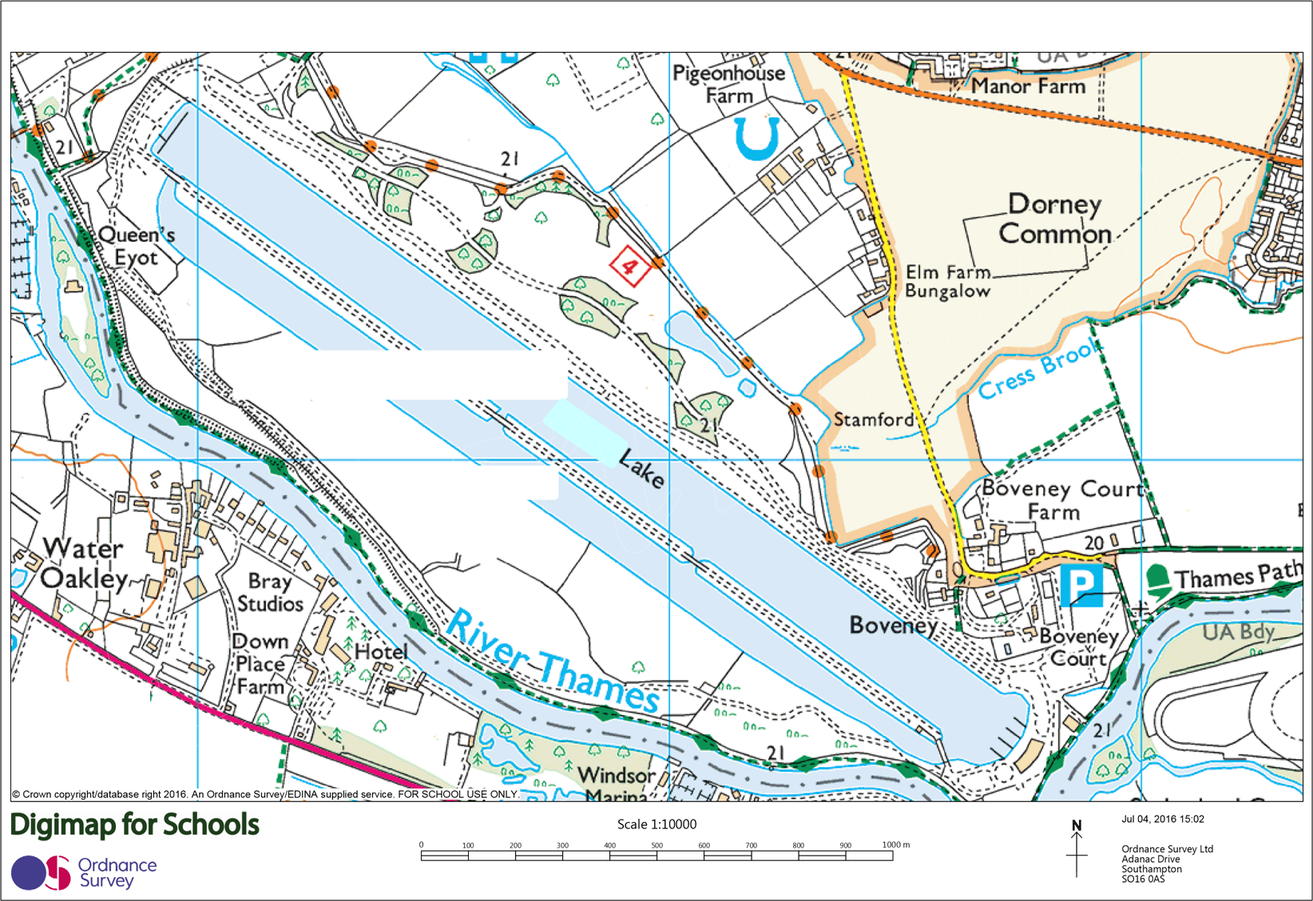
Map 4

Slide 6
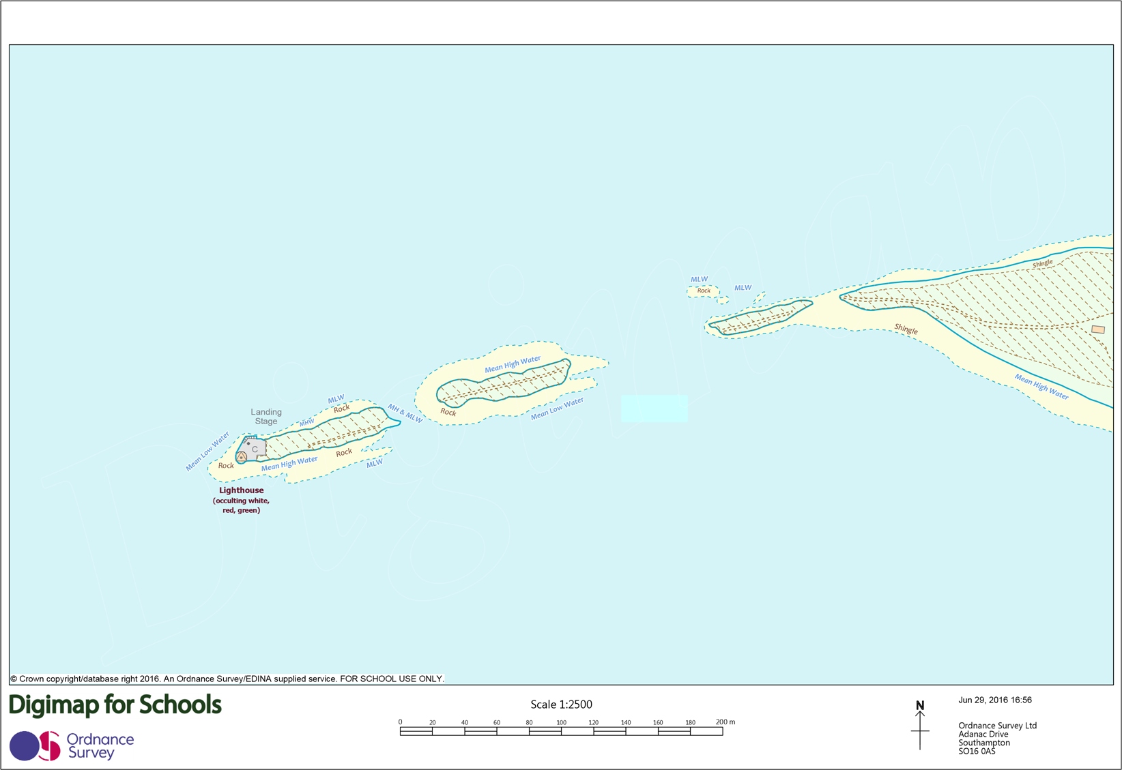
Map 5

Slide 7
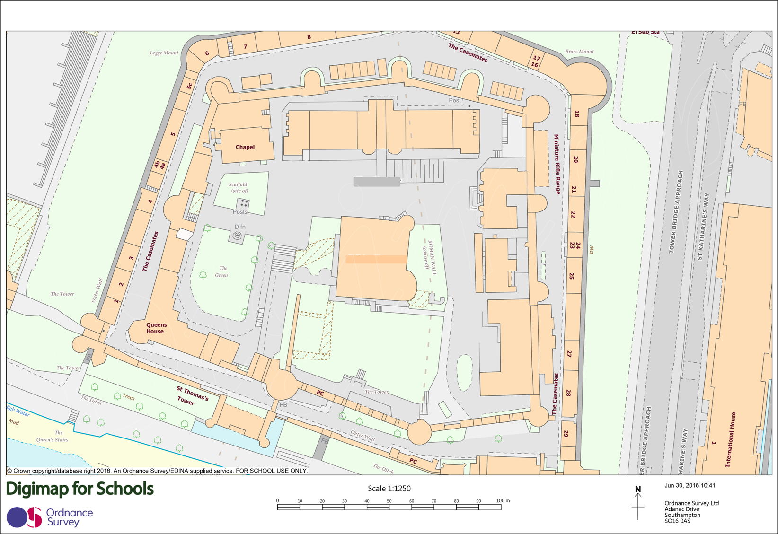
Map 6

Slide 8
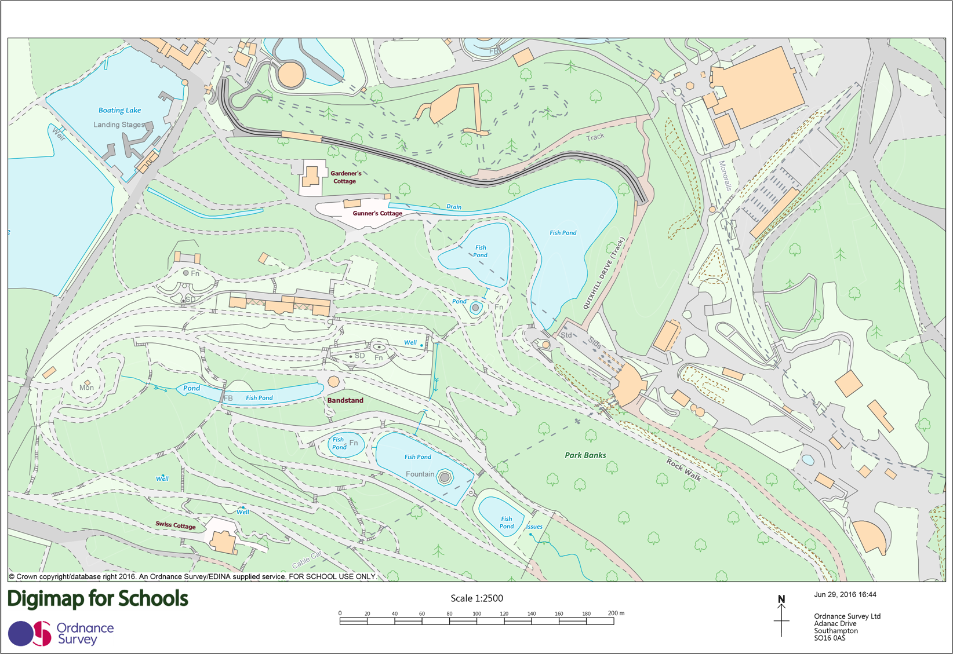
Map 7

Slide 9
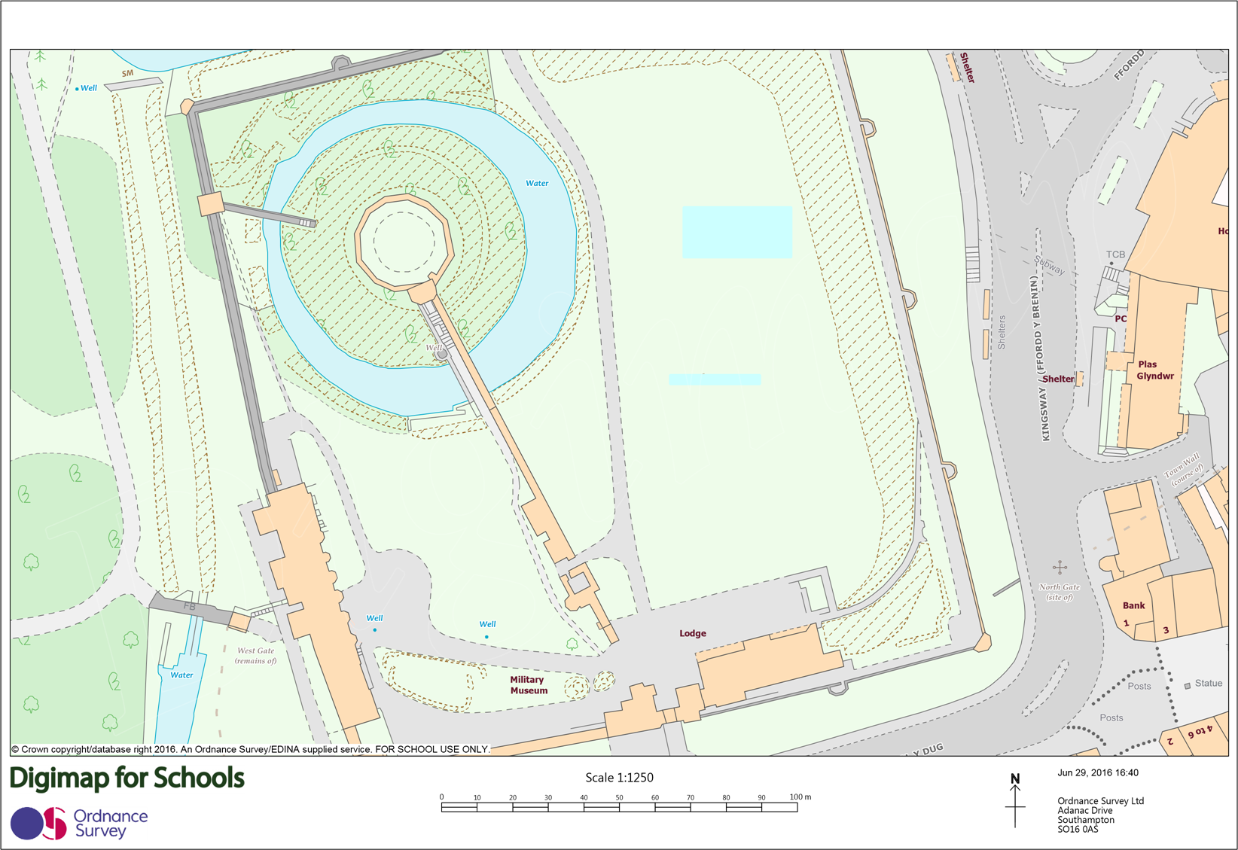
Map 8

Slide 10
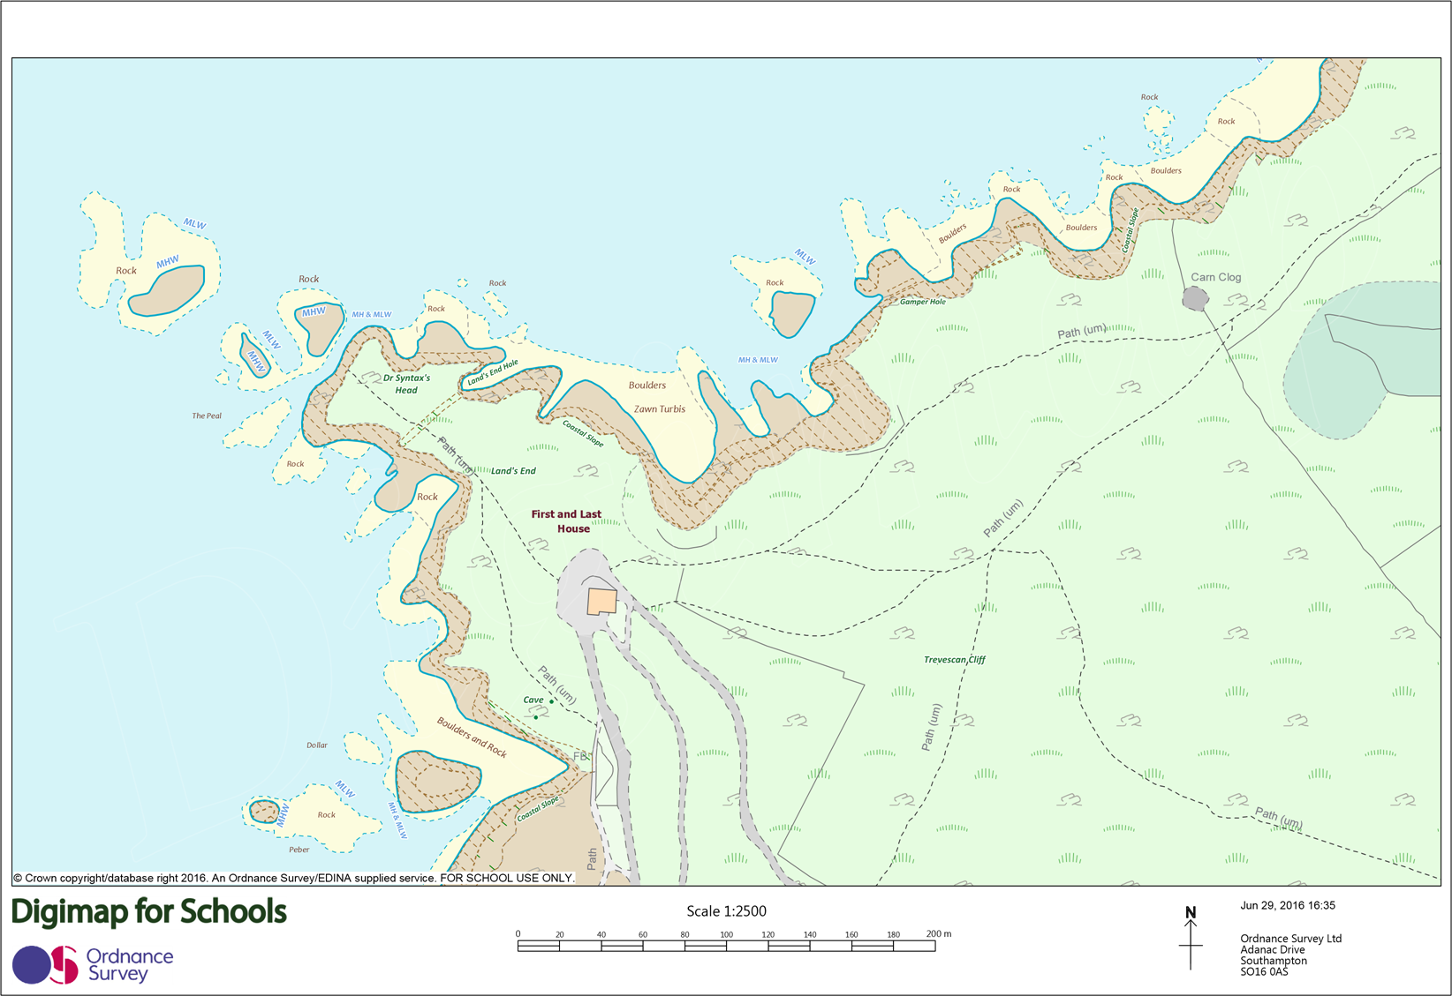
Map 9

Slide 11
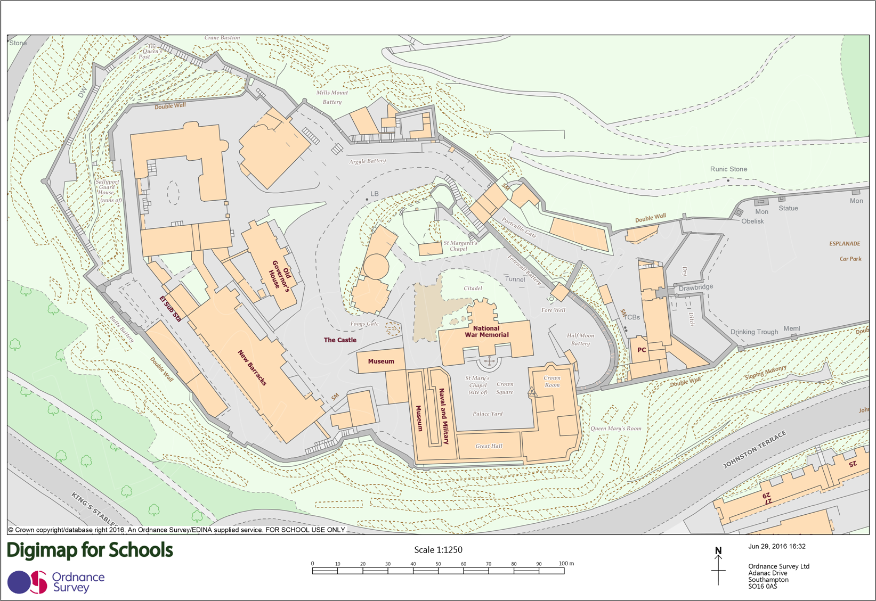
Map 10

Slide 12
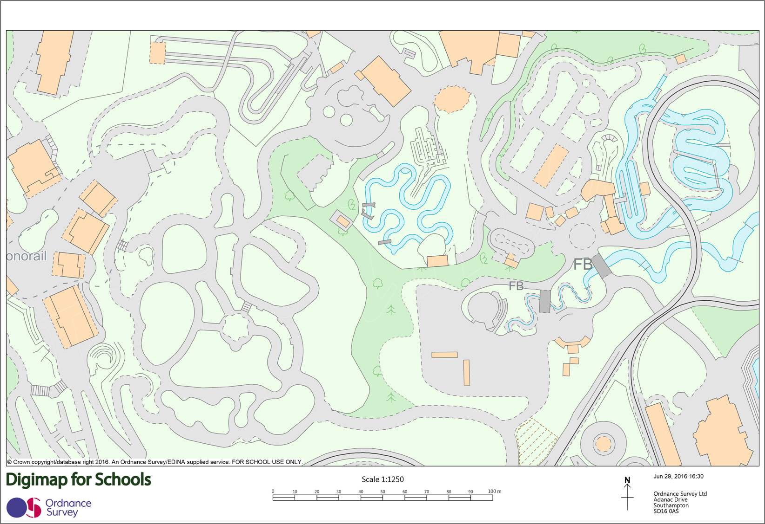
Map 11

Slide 13
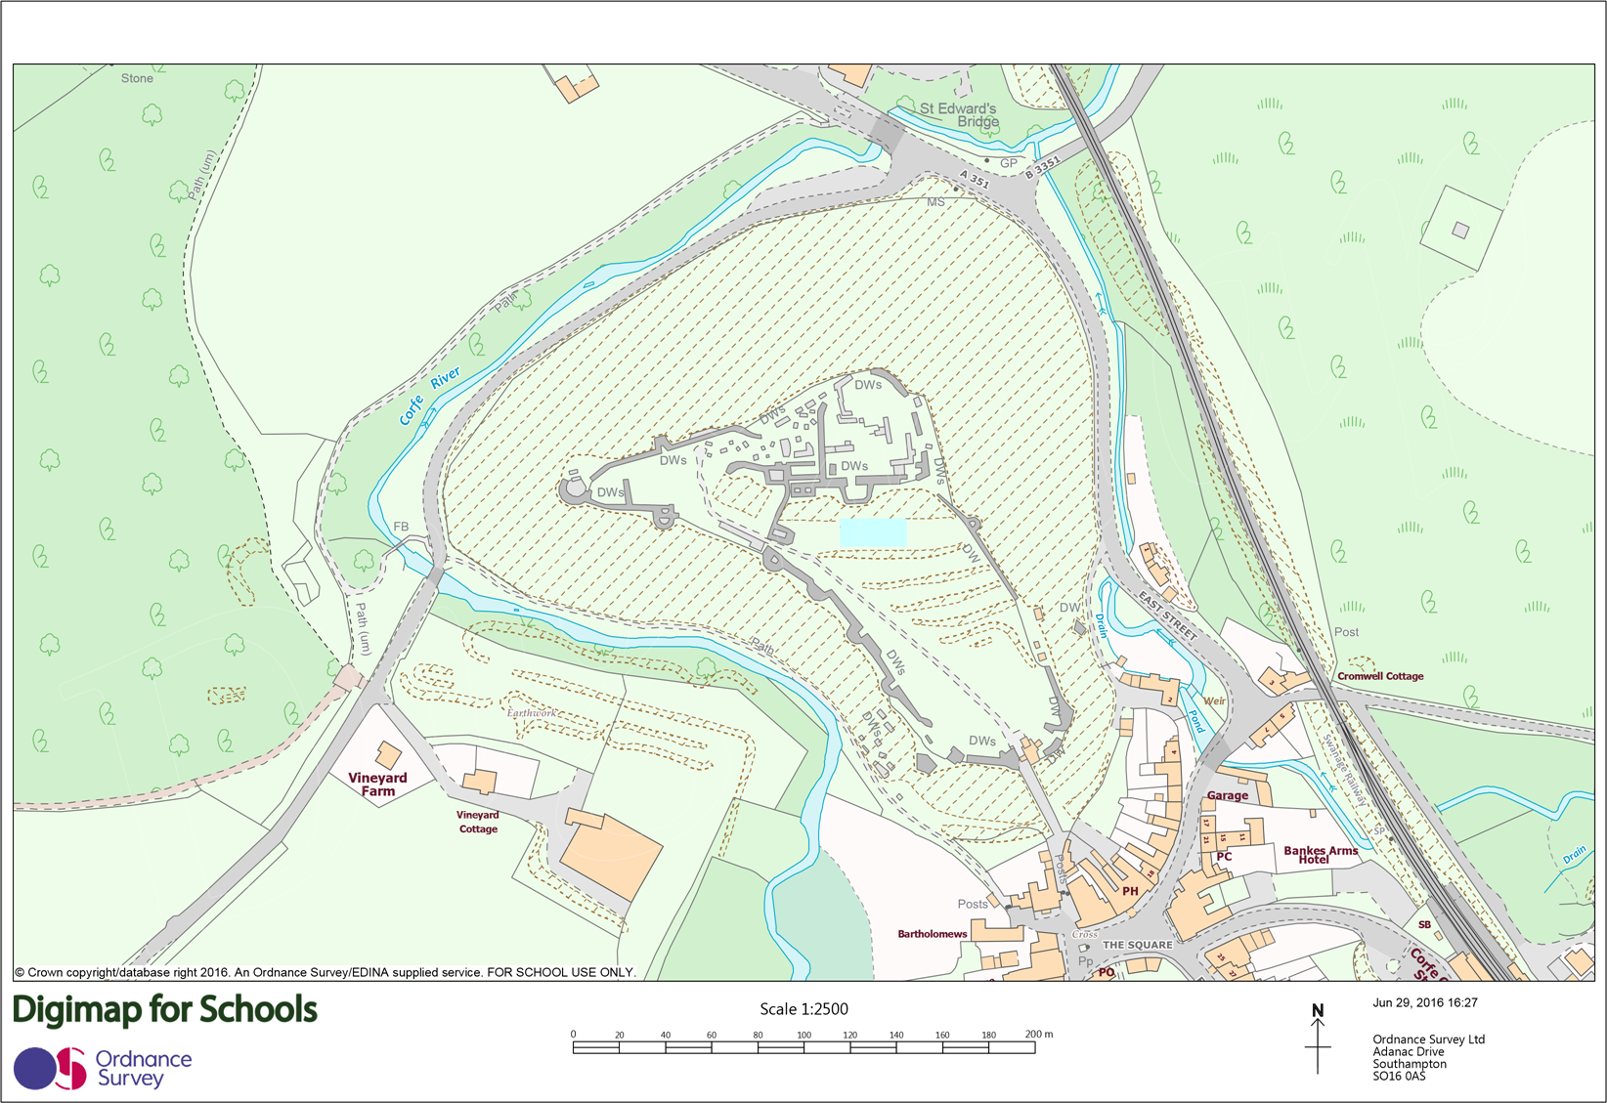
Map 12

Slide 14
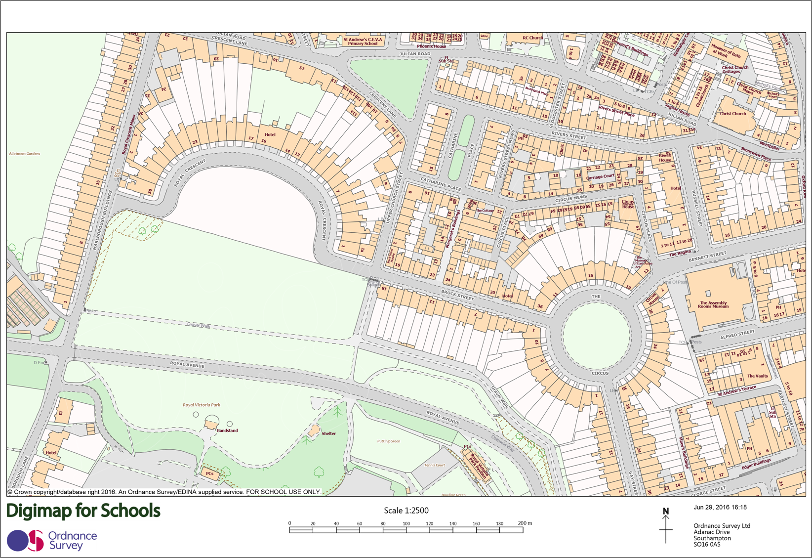
Map 13

Slide 15
Atebion
Map 1: Spaghetti Junction, Birmingham: SP 09269 90356
Map 2: Lundy, oddi ar arfordir gogleddol Dyfnaint: SS 13736 44062
Map 3: Lulworth Cove, yn Dorset: SY 82422 79918
Map 4: Llyn Rhwyfo Eton Dorney, ger Windsor: SU 92928 77880
Map 5: The Needles – Ynys Wyth: SZ 29115 84855
Map 6: Tŵr Llundain: TQ 33618 80550
Map 7: Alton Towers, Swydd Stafford: SK 07616 43337
Map 8: Castell Caerdydd, Caerdydd: ST 18077 76595
Map 9: Land’s End, Cernyw: SW 34242 25289
Map 10: Castell Caeredin: NT 25250 73486
Map 11: Legoland, ger Windsor: SU 93954 74775
Map 12: Castell Corfe, Dorset: SY 95963 82234
Map 13: Caerfaddon, Royal Crescent a The Circus: ST 74630 65313

