Slide 1
Artful Maps

Slide 2
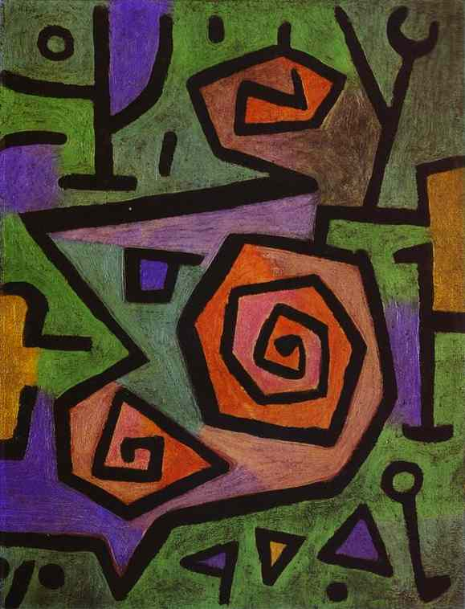
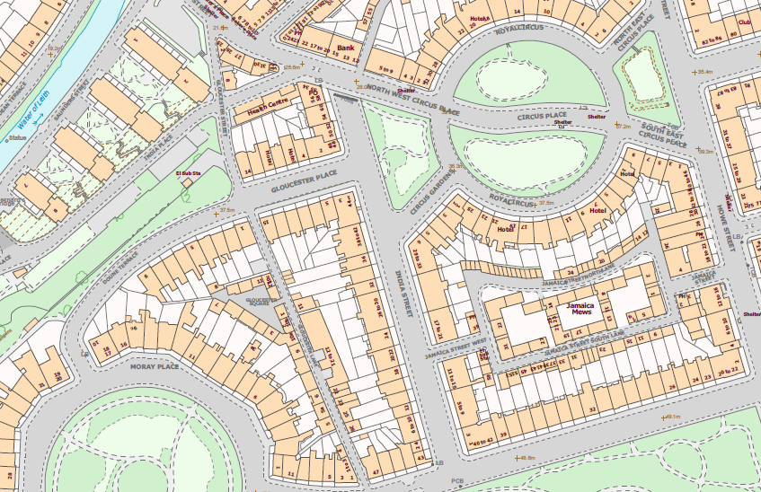
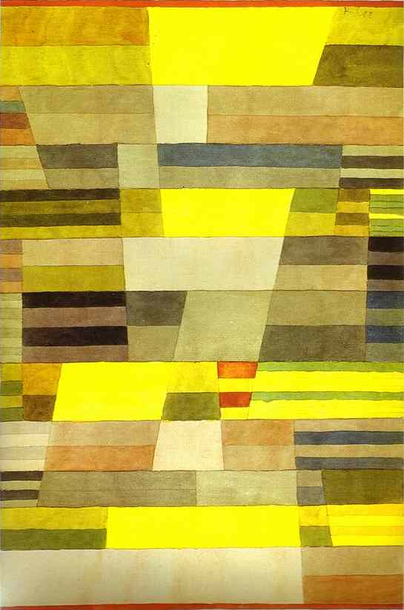
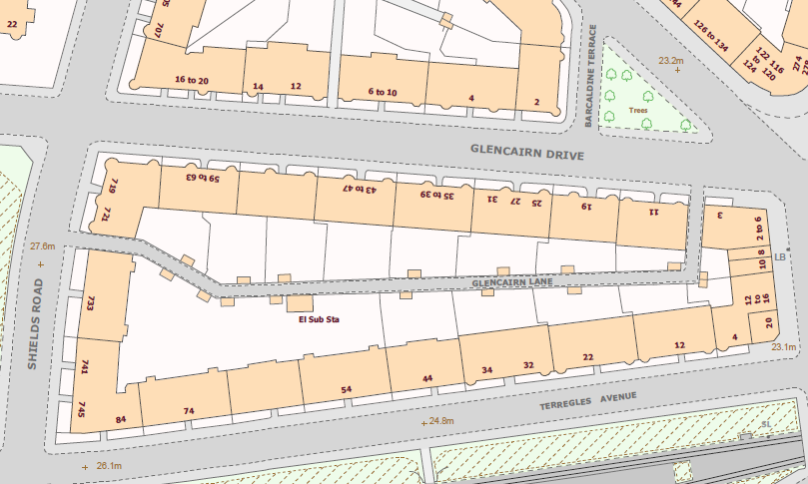
Art by Paul Klee
Curves and angles
Rectangles and lines
Maps of Edinburgh and Glasgow streets and housing

Slide 3
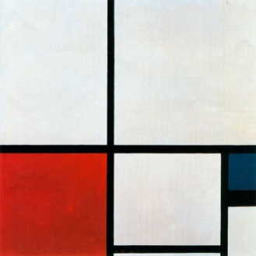
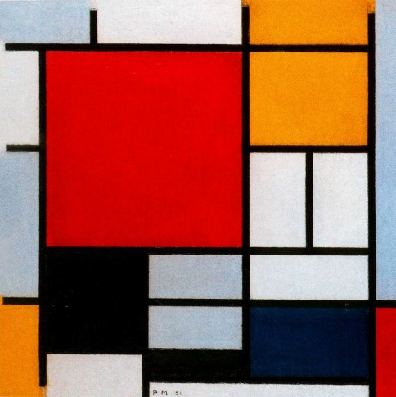
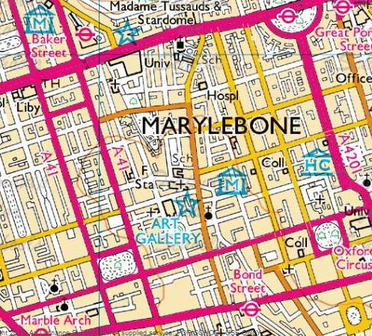
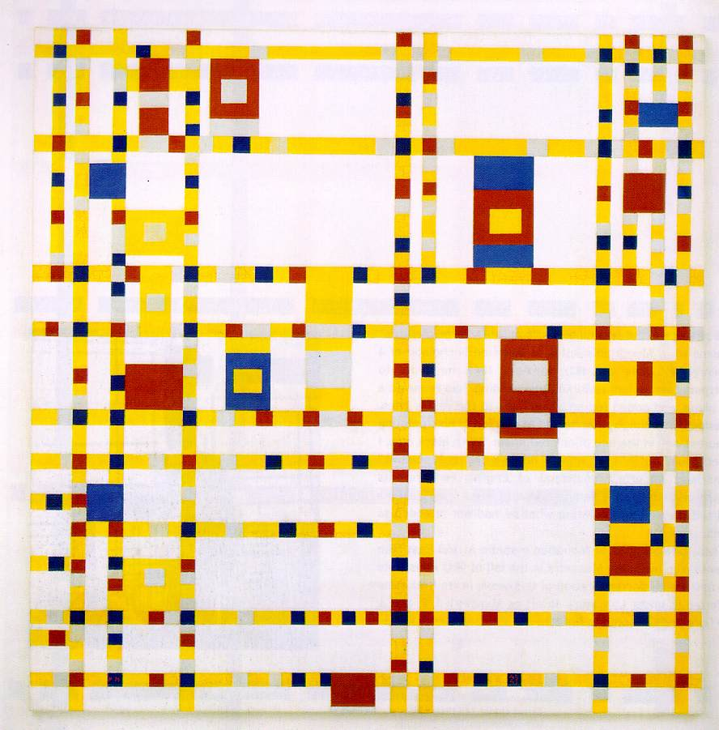
Art by Piet Mondrian
Straight lines and primary colours
Map of London roads

Slide 4
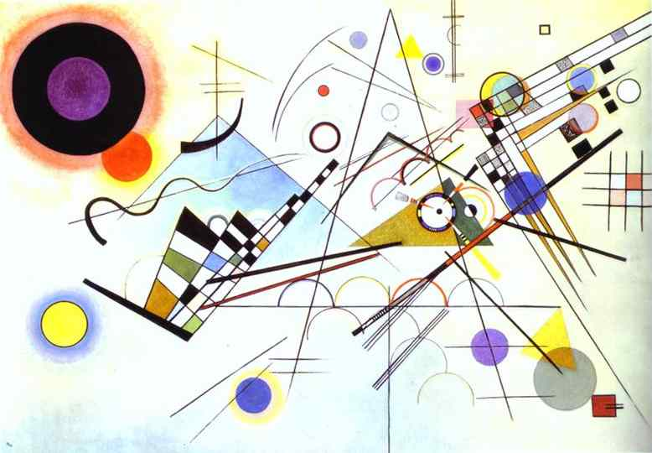
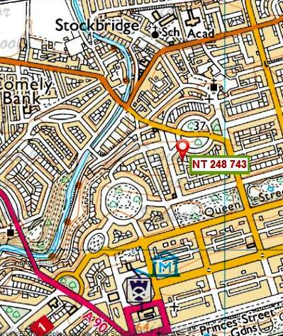
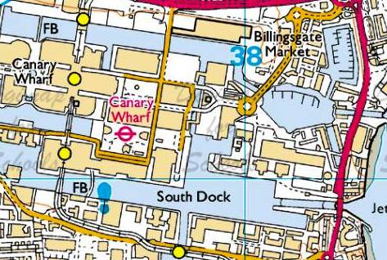
Art by Wassily Kandinsky
Assorted shapes and lines
Maps of London (Canary Wharf) and Edinburgh streets

Slide 5
Can you guess in which part of the country these patterns are?

Slide 6
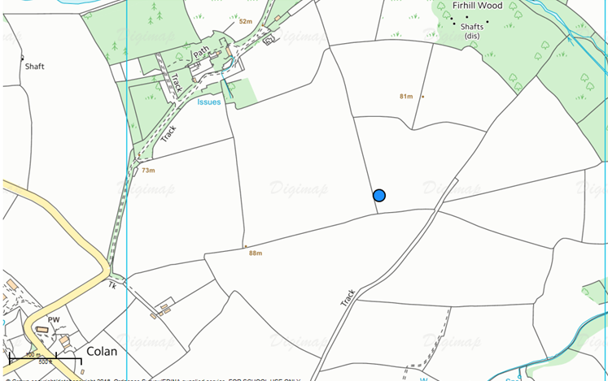
SW 8754 6157
Cornwall: field pattern

Slide 7
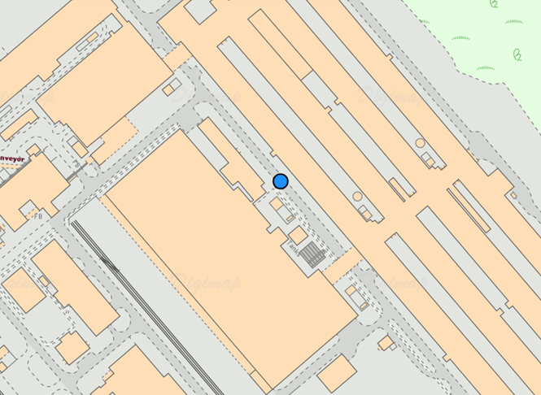
SH 26542 80966
Holyhead: factory pattern

Slide 8
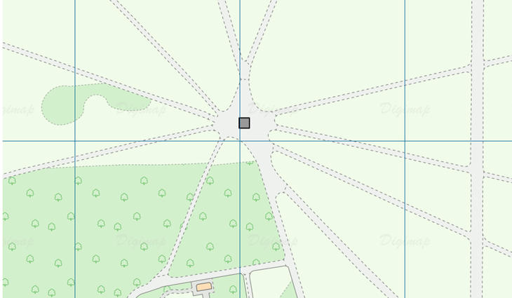
TQ 27703 80509
London: tracks in the park pattern

Slide 9
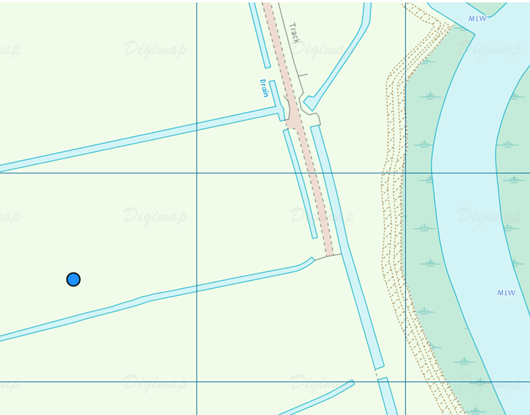
TG 44662 09860
Norfolk Broads: waterways and drains

Slide 10
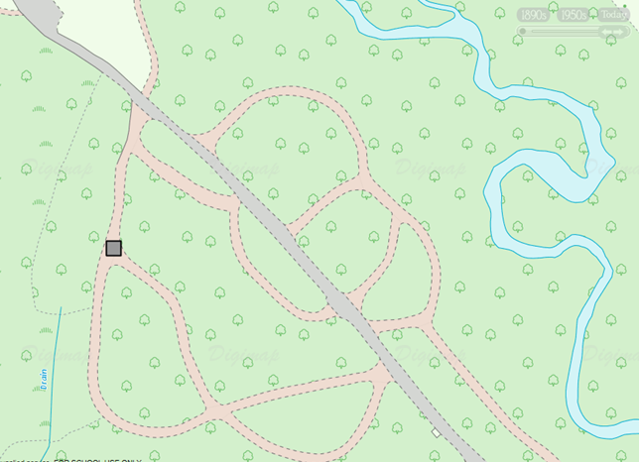
SU 27103 06963
New Forest: tracks

Slide 11
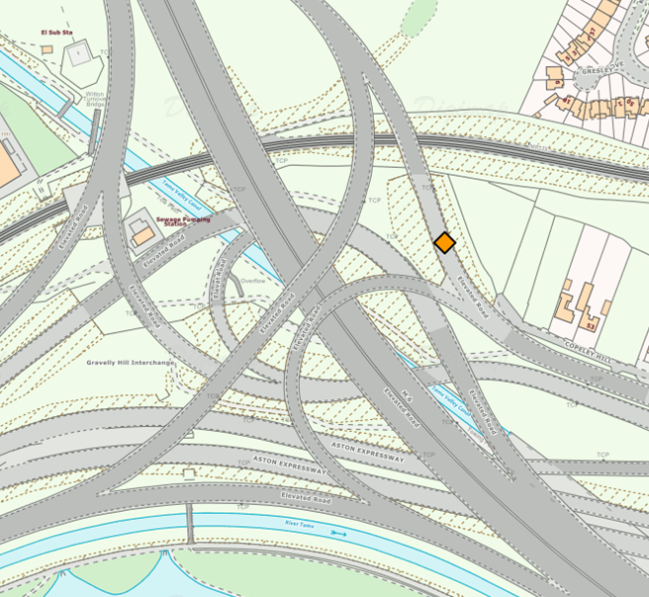
SP 09350 90388
Birmingham: motorway junctions

Slide 12
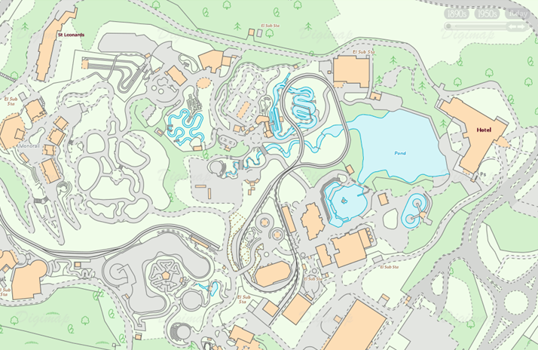
Legoland, Windsor

Slide 13
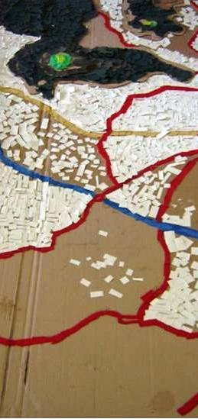
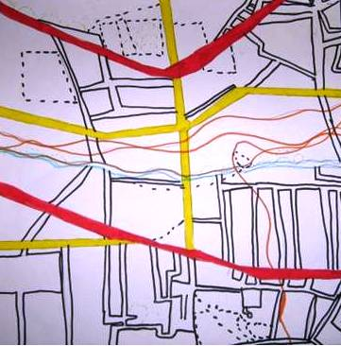
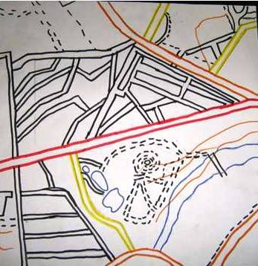
These pupils used felts and junk materials to create abstract works of art
Images courtesy Anthony Barlow

