Slide 1
Mountain Rescue!

Slide 2
Six figure Grid References
By estimating the eastings and northings to within 1/10 of the grid interval you can give a 6-figure grid reference that is accurate to within 100 metres on the ground.
See:
http://www.ordnancesurvey.co.uk/resources/maps-and-geographic-resources/the-national-grid.html

Slide 3
Six figure grid references
Help you to pinpoint locations
Remember – ‘along the corridor and up the stairs’
The first three figures are ‘eastings’ and you read these from left to right or eastwards
The second set of three figures is the ‘northings’ and you read these in a northerly direction.
N
E
Read eastings eastwards
Read northings northwards

Slide 4
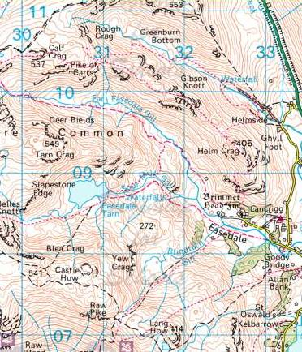
Reading a six figure Grid Reference
Grid Reference: NY 328 088
The first set of figures are the eastings (328)
The second set of figures are the northings (088)
Figures on the map showing numbers 30, 31, 32, 33 are eastings
Start at easting 32 go 8/10 of the way along the distance between 32 and 33 to find 328
Start at northing 08 and go northwards 8/10 of the distance to 09 to find 088
eastings
northing 088
northings
Easting 328
See: http://www.ordnancesurvey.co.uk/resources/maps-and-geographic-resources/the-national-grid.html

Slide 5
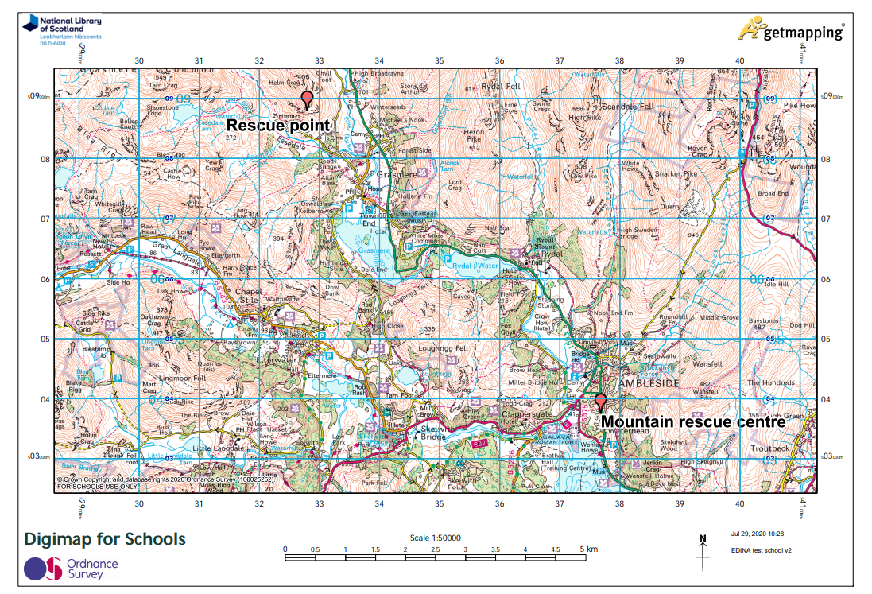
Use the right scale map to show start and finish

