Slide 1
It’s a Rubbish Footprint
Discuss these headlines and collect some of your own

Slide 2
UK ‘landfill dustbin of Europe’
The UK dumps more household waste into landfill than any other country in the European Union, research by the Local Government Association shows.
UK households sent 26.7 million tonnes of rubbish to landfill in 2014.
Although the UK recycling rate of ‘waste from households’ reached 44.9 per cent in 2014, rising from 44.1 per cent in 2013 and compares to 40.4 per cent in and 2010/11. However, rubbish sent to landfill still poses as a problem – GOV.UK

Slide 3
The Problem with landfill
Every year, the average bin contains enough unrealised energy for 500 baths, 3500 showers or 5,000 hours of television.
On average every person in the UK throws away their own body weight in rubbish every 7 weeks
Every 8 months the UK produces enough waste to fill Lake Windermere (the largest lake in England)
In less than 2 hours the UK produces enough waste to fill the Albert Hall
rutland.gov.uk

Slide 4
Rubbish and fly tipping fires cost £22 million to tackle
Rubbish fires are costing taxpayers millions of pounds a year, according to the Scottish Fire Service.
Most fires involving rubbish and fly tipping last year were started deliberately.
The cost of dealing with these fires was about £2000 per attendance .
In 2014/15 there were 900 thousand incidents of fly tipping and local authorities spent nearly £50 million clearing the fly tips.
This is up from 852 thousand fly tipping incidents, and £45.2 million spent in 2013/14

Slide 5
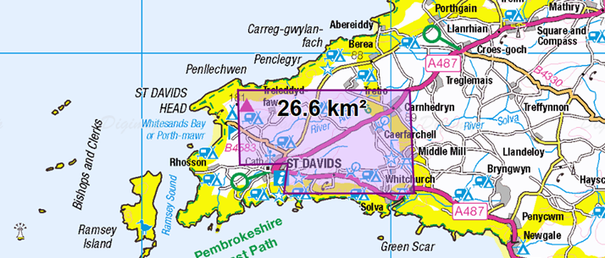
If a million household produce a square kilometre of rubbish a week between them, all the households in Great Britain would produce about 26 Km²
This is what goes to landfill each week – where would you put it?

Slide 6
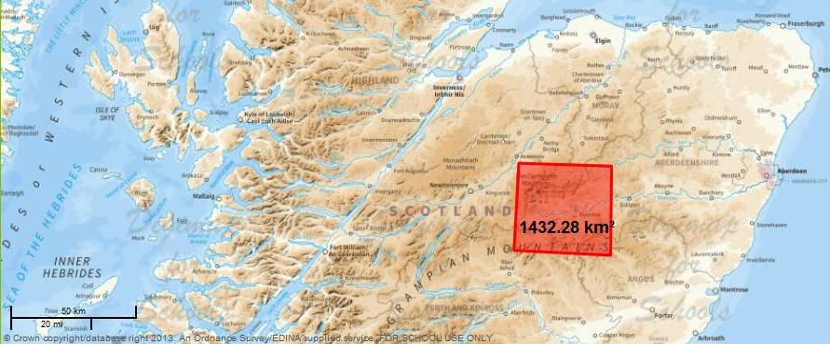
This is what a year’s worth of rubbish from Great Britain households might look like.

