Slide 1
Landscape Fingerprints

Slide 2
Ben Nevis is the highest mountain in the British Isles (1,343 metres)

Slide 3
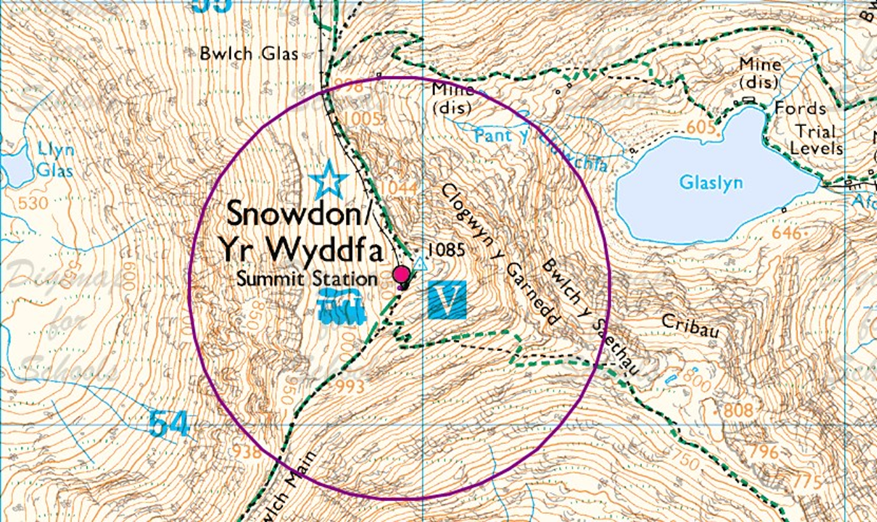
Snowdon is the highest mountain in Wales (1,085 metres)

Slide 4
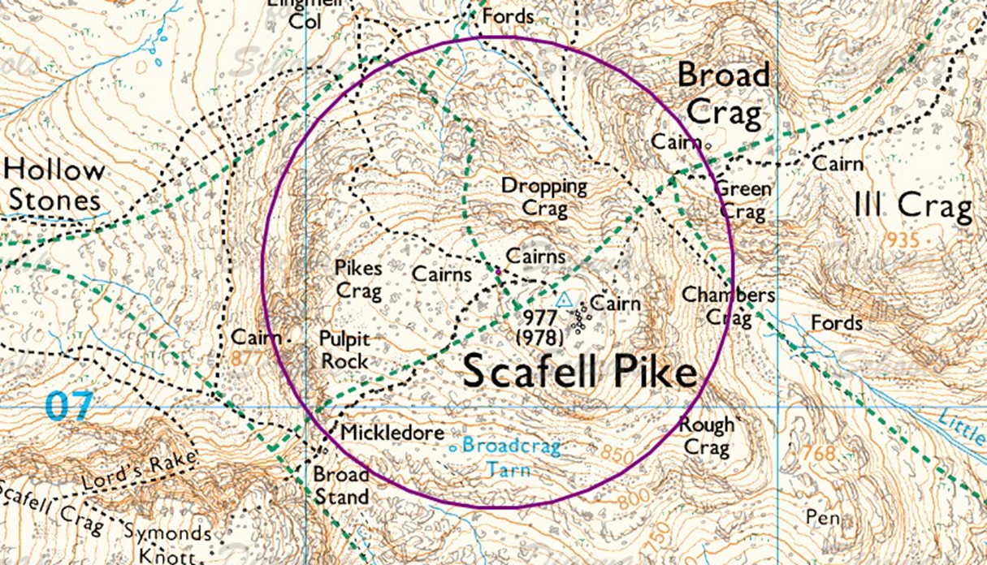
Scafell Pike is the highest mountain in England (978 metres)

Slide 5
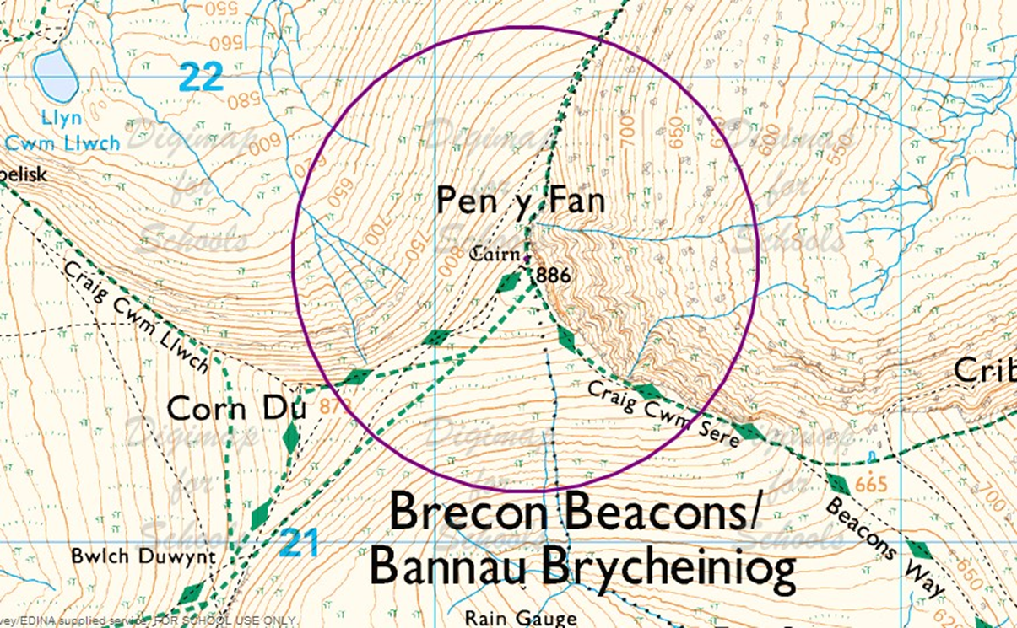
Pen Y Fan is the highest peak in South Wales and southern Britain (886 metres)

