Slide 1
Discovering where in atlases

Slide 2
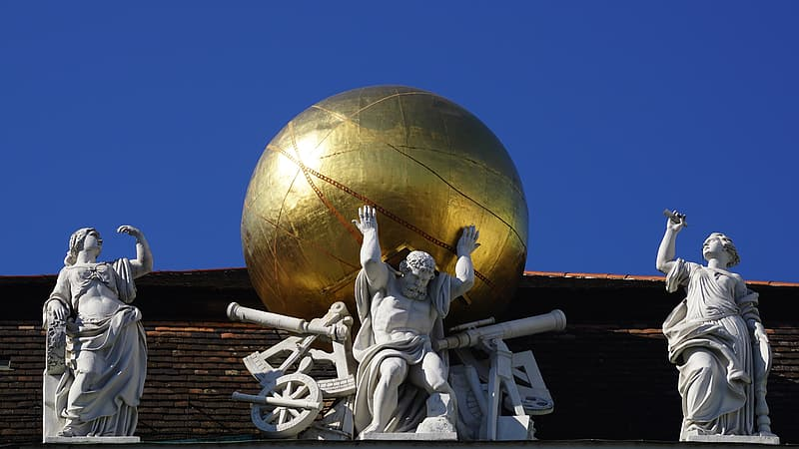
Atlas
In Greek mythology, Atlas was a leader of the Titans in their war against Zeus (the King of the Gods). After their defeat, he was condemned to carry the heavens upon his shoulders.

Slide 3
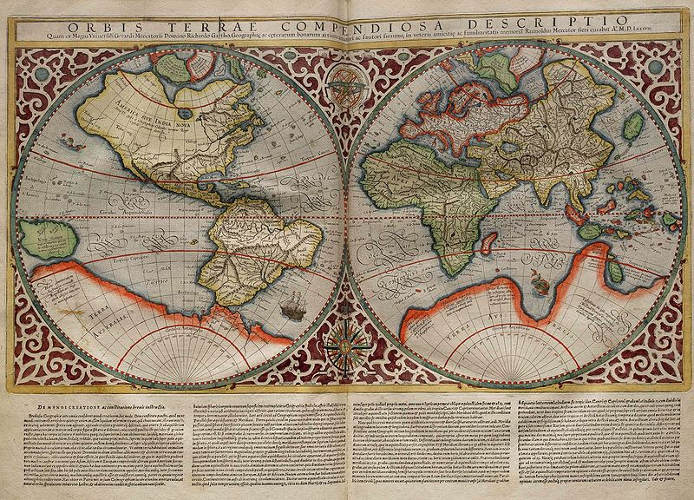
Mercator
Gerardus Mercator was a very famous map maker.
He called his collection of maps, published in 1595, an atlas.

Slide 4
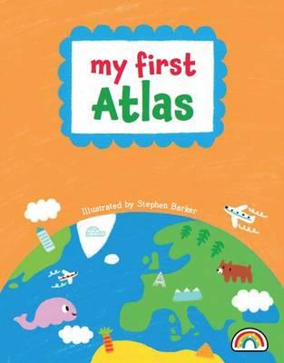
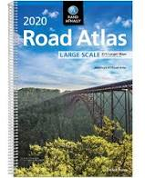
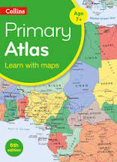
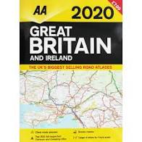
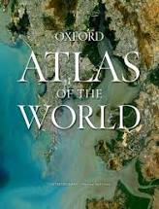
Modern atlases
Over the years, world atlases have developed enormously, ranging from very detailed reference atlases, e.g. The Times Atlas of the World, to more simplified ones aimed at very small children, e.g. My First Atlas.
There are also atlases that have a specific purpose e.g.:
road atlases for navigation;
thematic atlases to show climate or land use.
Some atlases are online/electronic and contain up-to-date information about places and features around the world, e.g. Digimap for Schools.

Slide 5
Compass points (KS1)
The four main (cardinal) compass directions are:
North
East
South
West
Tips to remember!
Never Eat Shredded Wheat.
Never Eat Slimy Worms.
Naughty Elephants Spray Water.
Can you make up your own way to remember?

Slide 6
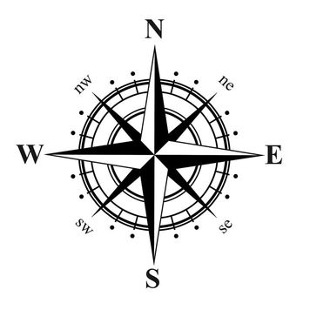
Compass points (KS2)
The four main (cardinal) compass directions are:
North, East, South, West
4 intercardinal points:
North East
South East
South West
North West
Tips to remember!
Never Eat Shredded Wheat.
Never Eat Slimy Worms.
Naughty Elephants Spray Water.
Can you make up your own way to remember?

Slide 7
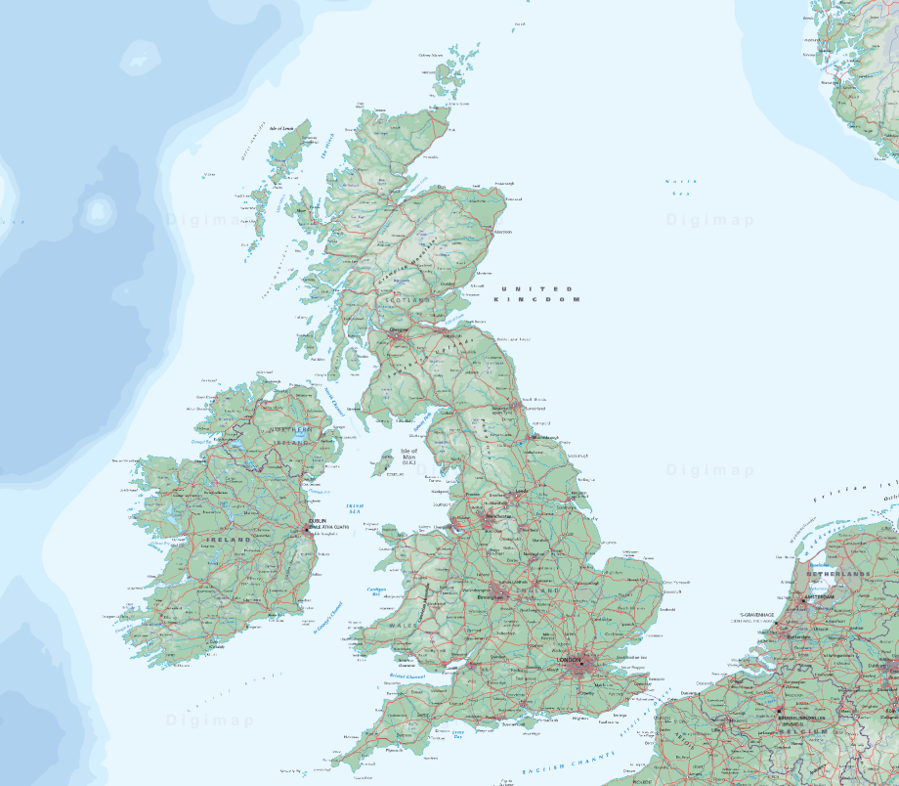
Which way is north?
In Digimap for Schools, north is always at the top of the map.

Slide 8
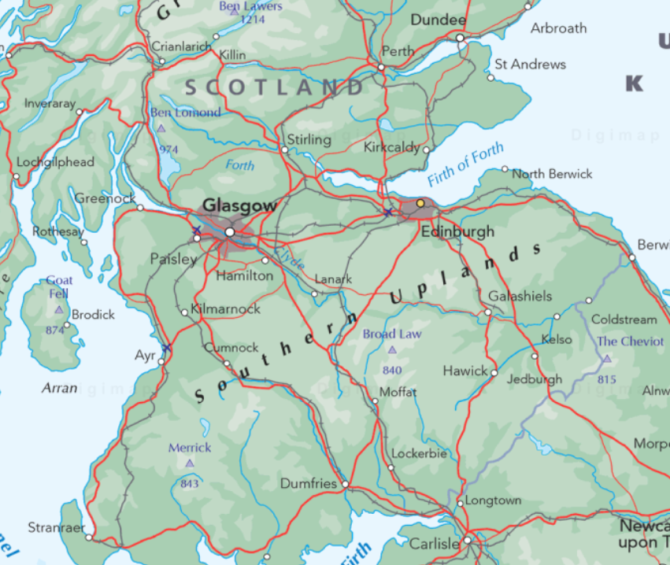
Which direction did I go?
Started at Edinburgh.
Left the train at Glasgow.

Slide 9
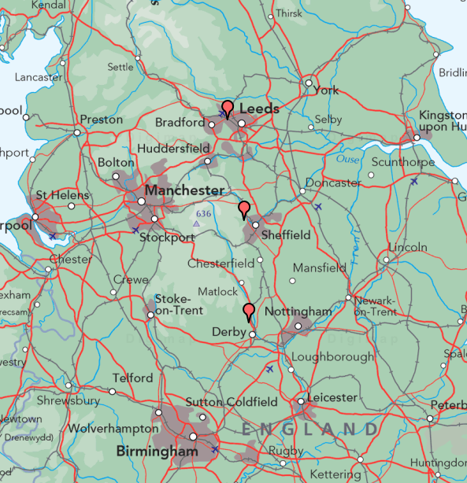
Which direction did I go?
Started at Derby.
Went to Sheffield.
Stopped at Leeds.

Slide 10
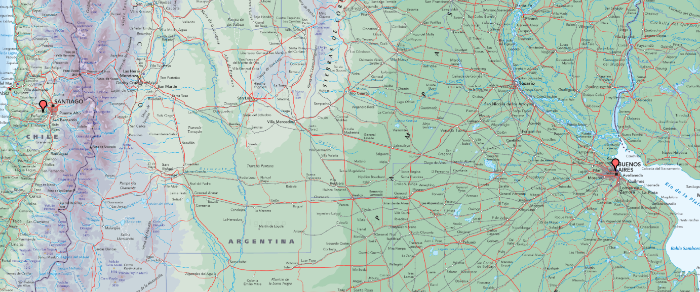
Which direction did I go?
Started in Santiago in Chile.
Flew to Buenos Aires in Argentina.

Slide 11
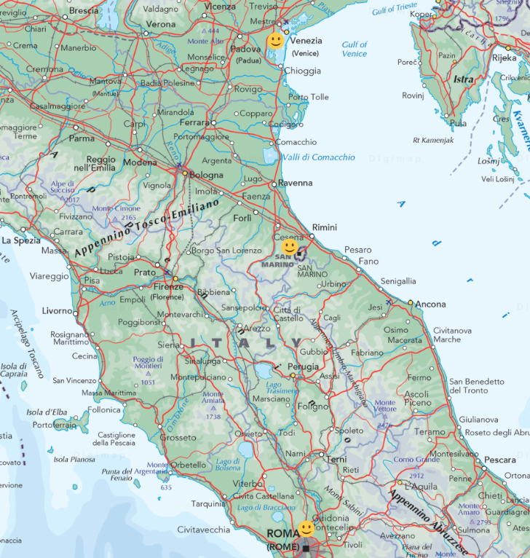
Which direction did I go?
Started in Venice.
Went to San Marino.
Stopped in Rome.

Slide 12
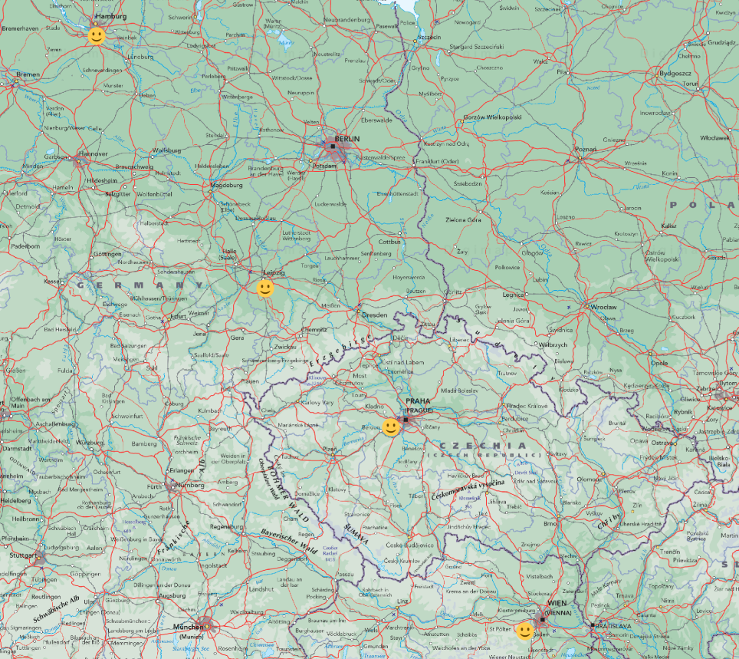
Which direction did I go?
Started in Hamburg.
Went to Leipzig.
Stopped in Prague.
Finished journey in Vienna.

Slide 13
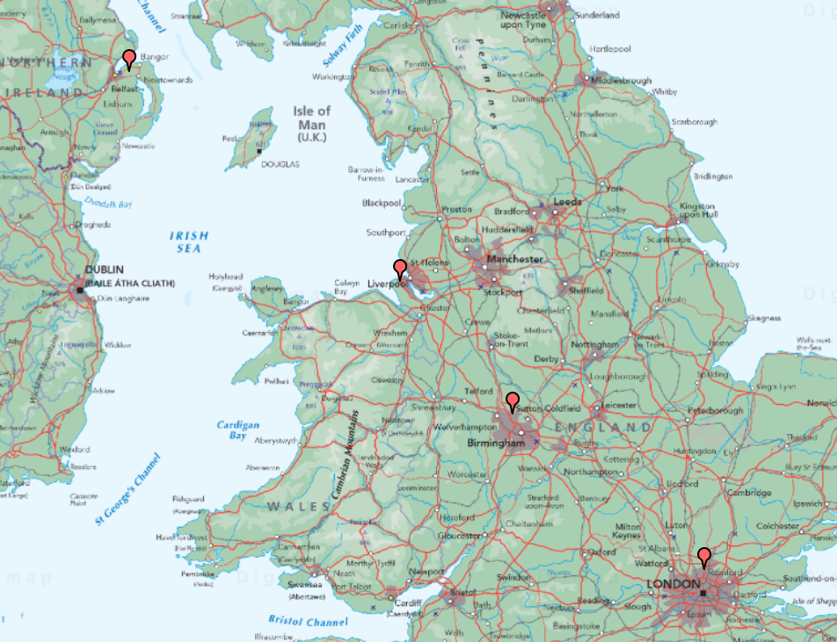
Which direction did I go?
Started in London.
Went to Birmingham.
Stopped in Liverpool.
Finished in Belfast.

Slide 14
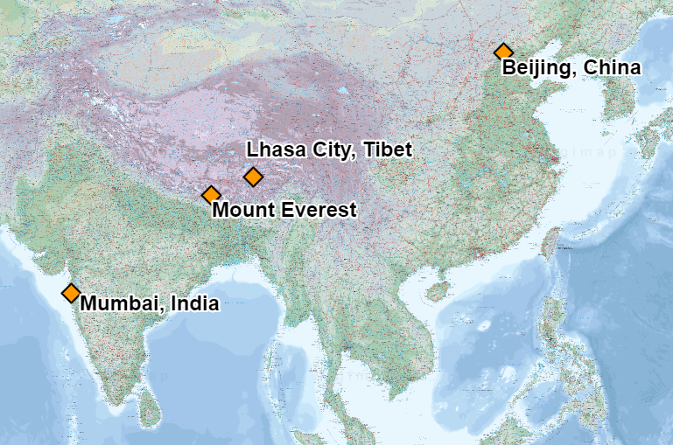
Which direction did I go?
Started in Beijing.
Stopped in Lhasa City.
Climbed Mount Everest!
Finished journey in Mumbai.

