Slide 1
Patterns of Land Use

Slide 2
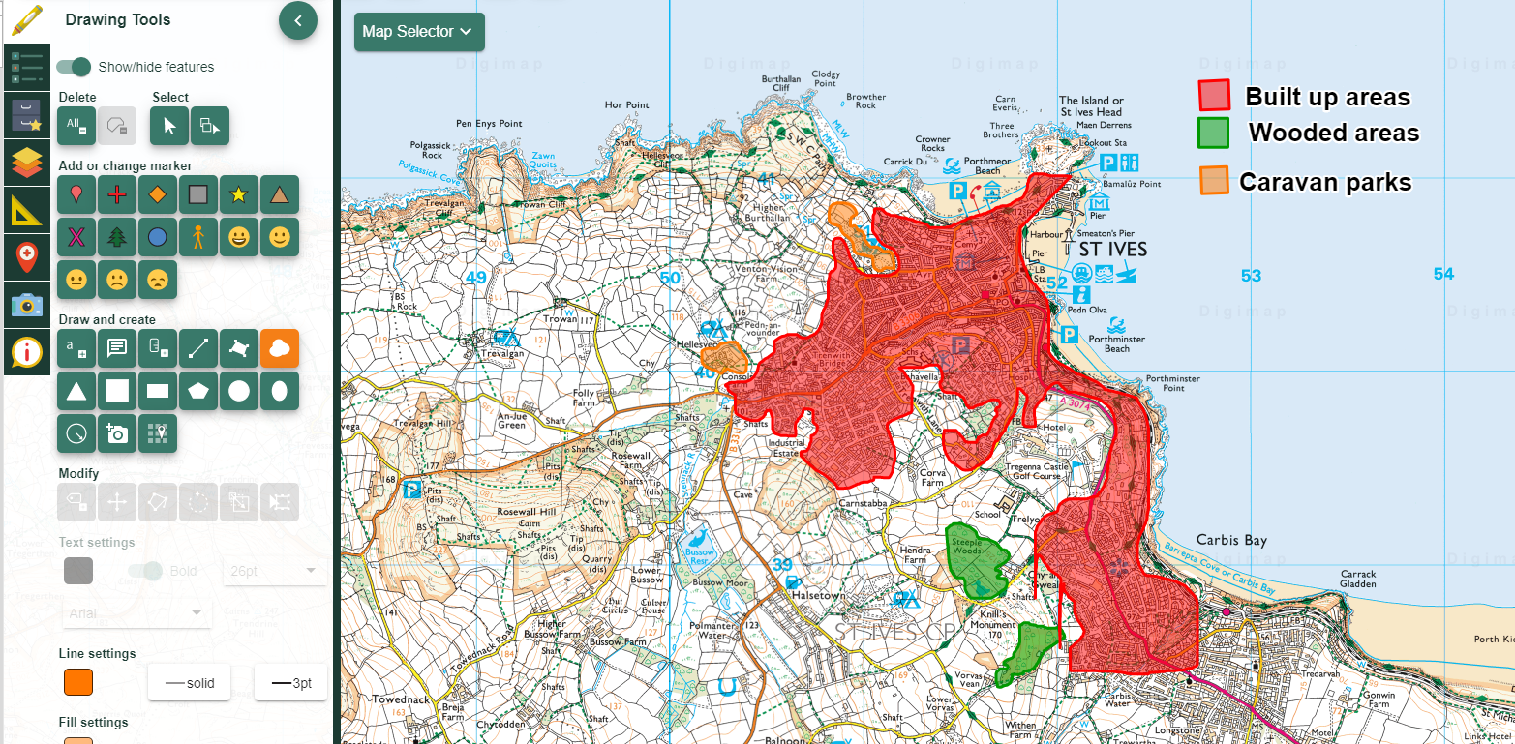
Using the ‘Draw Area’ freehand tool to highlight the main ‘built’ area of St Ives, Cornwall

Slide 3
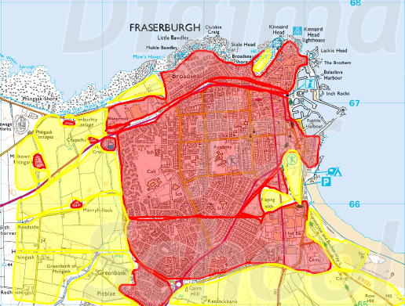
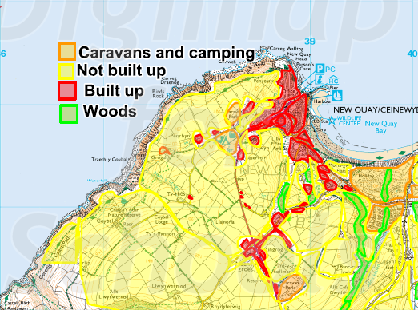
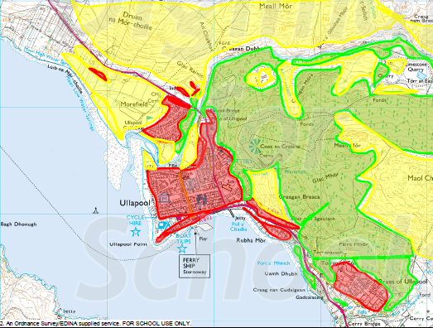
Fraserburgh
Weymouth
Simple land use comparisons: 1:25 000 scale. What do you notice?
New Quay
Ullapool

Slide 4
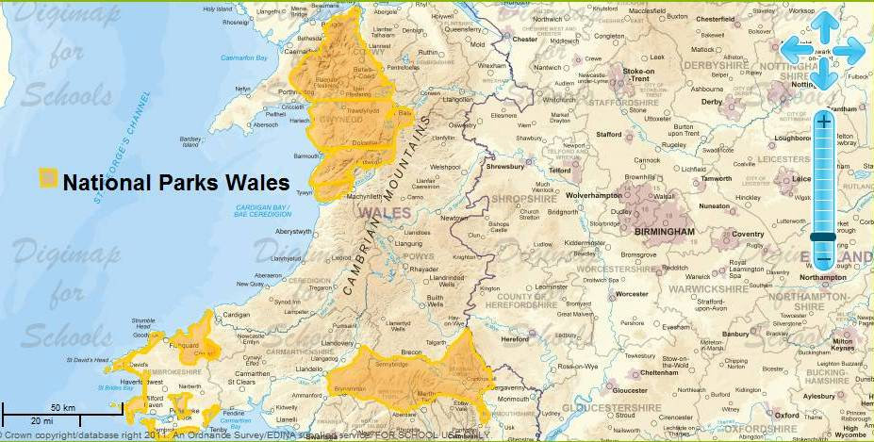
Highlighting the National Parks of Wales: what kinds of landscapes are these?

