Slide 1
Quick geography ideas with a historic twist

Slide 2
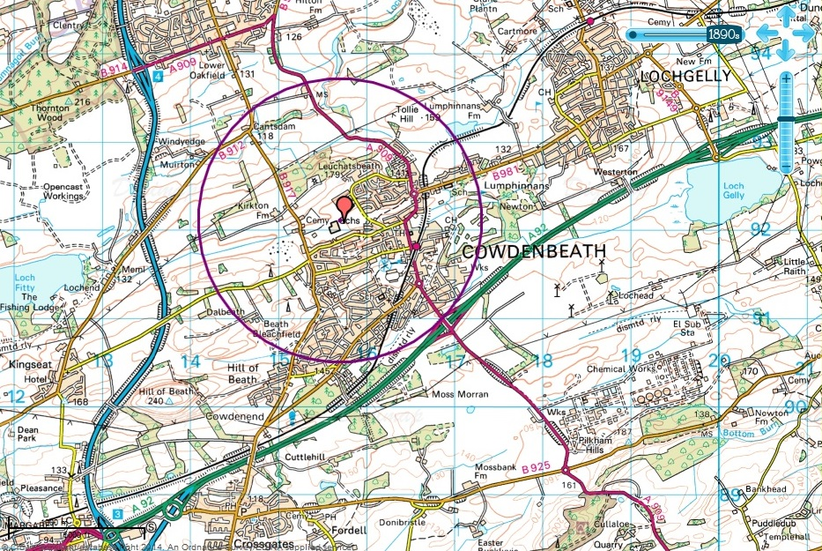
COWDENBEATH

Slide 3
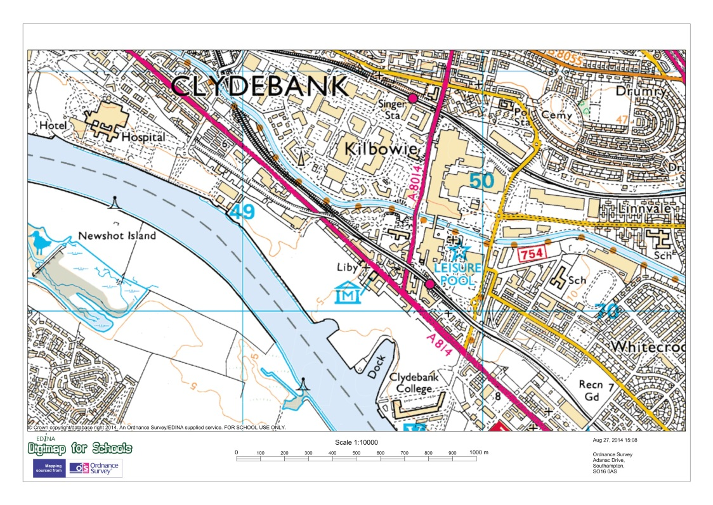
Kilbowie/Singer

Slide 4
Stamford – Old A1 river bridge crossing
Image: Ken Lacey

Slide 5
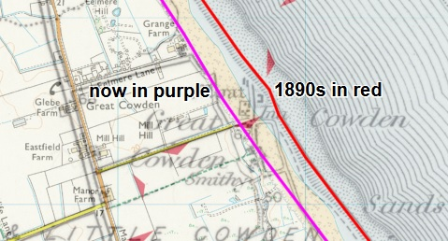
Great Cowden – coastal erosion
© Copyright Andy Beecroft and licensed for reuse under Creative Commons Licence

Slide 6
Clavell Tower - Dorset
© Copyright Phil Halling and licensed for reuse under Creative Commons Licence

Slide 7
Forth Road bridge – original and new construction

Slide 8
Severn railway Bridge – come and gone
© Copyright Ben Brooksbank and licensed for reuse under Creative Commons Licence

Slide 9
Donibristle air station - now Dalgety Bay
© Copyright M.J. Richardson and licensed for reuse under Creative Commons Licence

Slide 10
Newark Airfield – Agricultural Society’s Showground

Slide 11
Thirsk Airfield – reused as a Turkey farm

Slide 12
Hunstanton – a lost pier

Slide 13
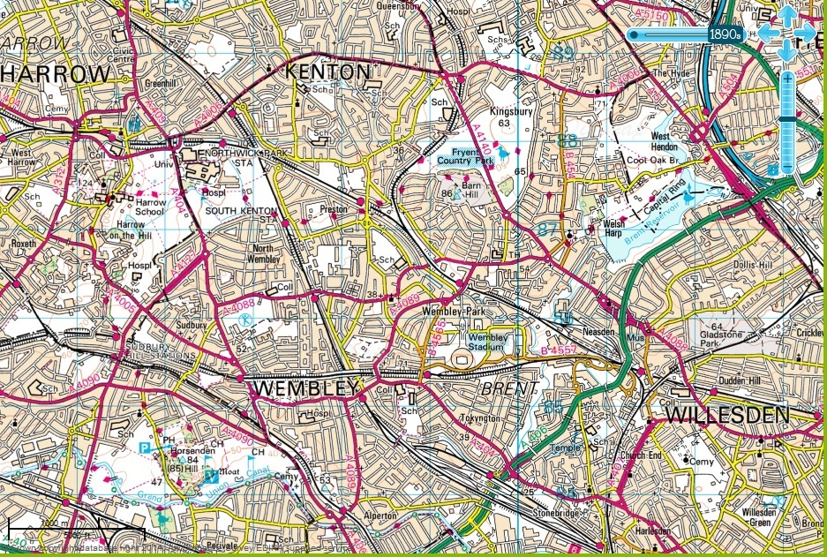
Metroland – centred on Harrow on the Hill

Slide 14
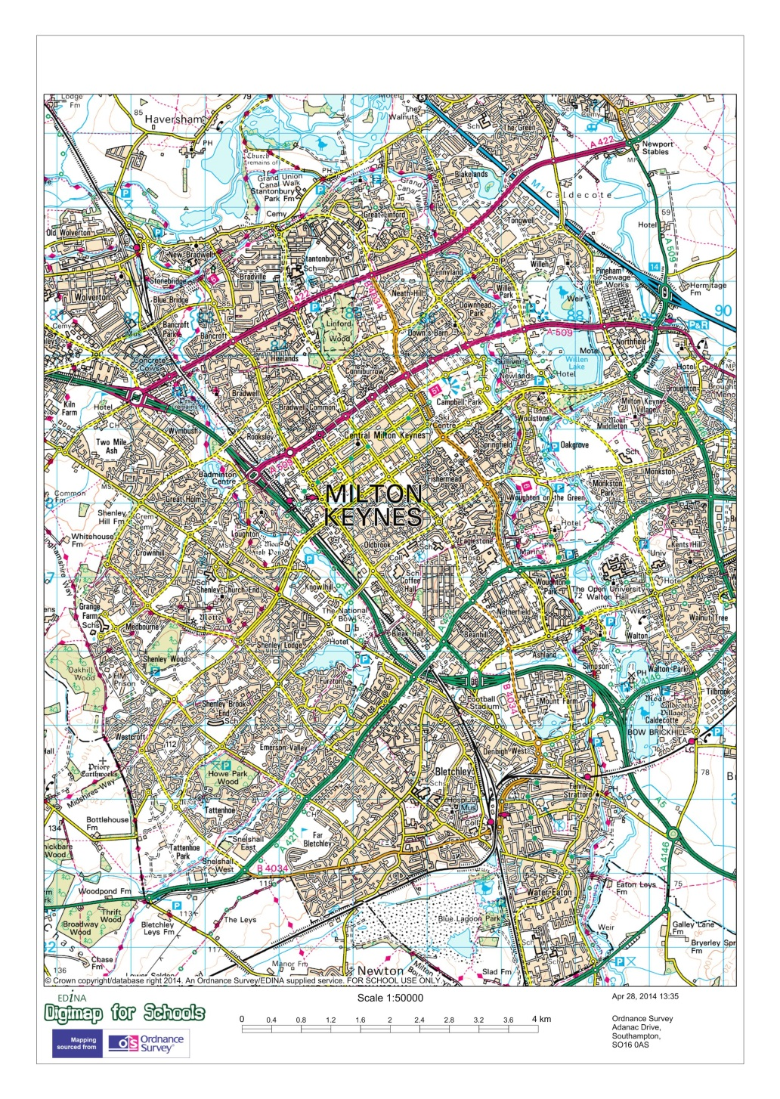
Milton Keynes – 1890 and 2014

Slide 15
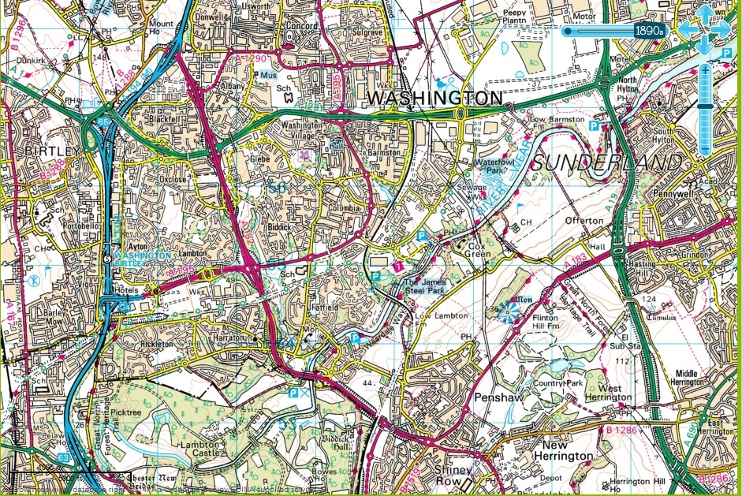
Washington – 1890 and 2014

