Slide 1
Teifi Travels

Slide 2
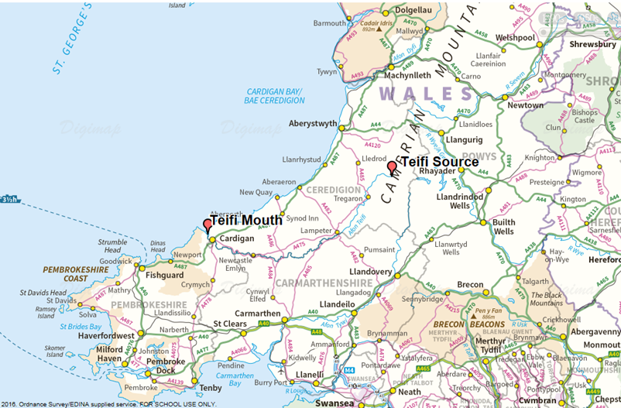
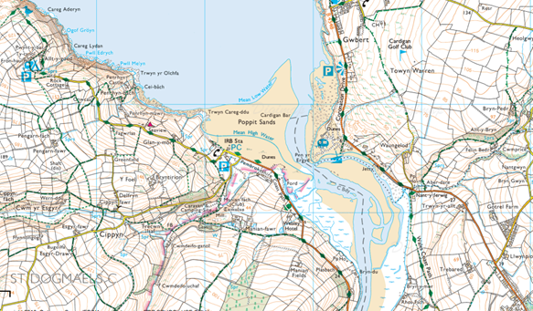
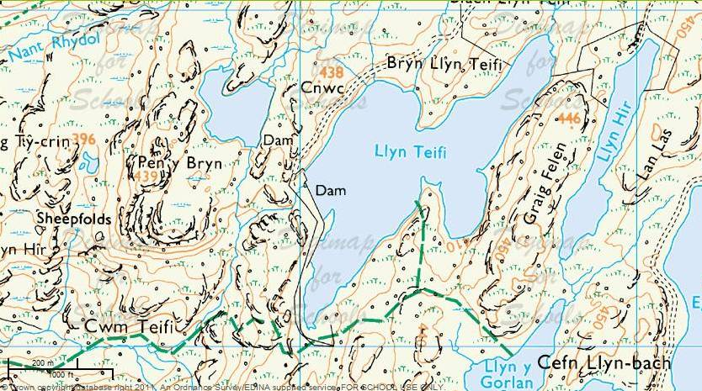
The River Teifi and its tributaries are designated Sites of Special Scientific Interest (SSSI) and are also a Special Landscape Area. The river runs through some of the most beautiful landscapes of mid west Wales

Slide 3
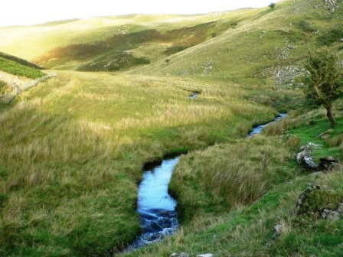
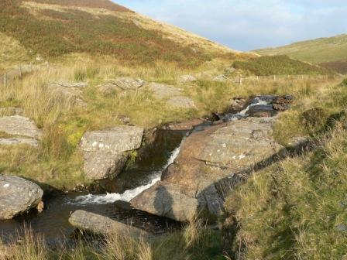
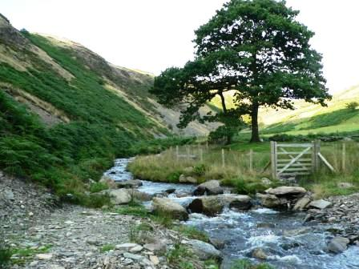
River Teifi source
The Teifi begins its journey to the sea as a tiny stream from Llyn Teifi, one of a group of lakes high in the Cambrian mountains, mid Wales.
Would you like to go climbing here?

Slide 4
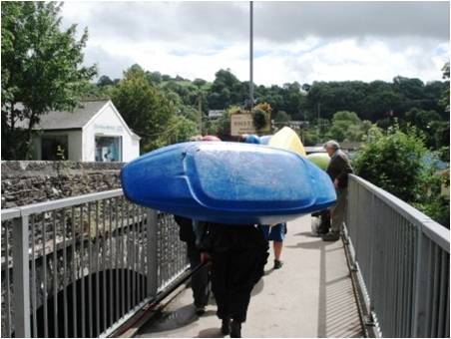
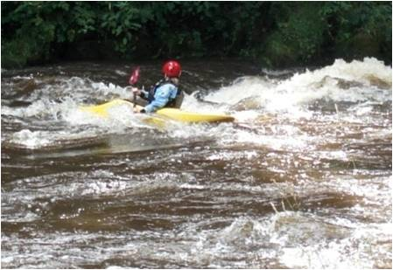
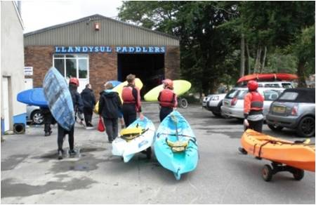
Llandysul
The Teifi enters the small town of Llandysul in wide meanders and leaves under the town’s bridge as rapids over bed-rock.
Would you brave the rapids in a kayak?
The rapids at Llandysul are popular with canoeists and kayakers.

Slide 5
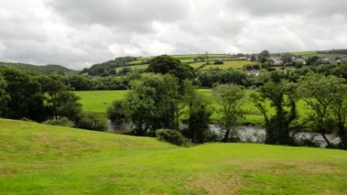
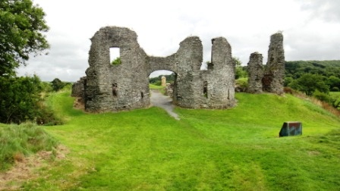
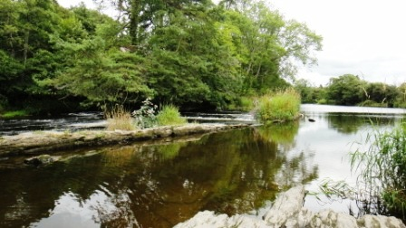
Newcastle Emlyn
Do you know any legends?
A ruined castle stands on top of a hill overlooking the broad flowing Teifi at the small market town of Newcastle Emlyn.
A local legend says that long ago, a winged wyvern landed on the castle and was killed by a soldier. Its blood turned the river black and killed all the fish.

Slide 6
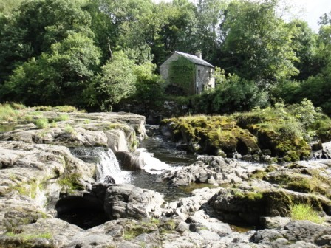
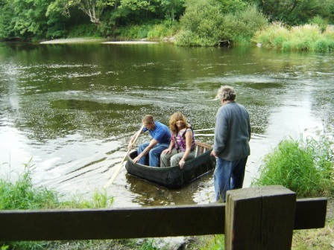
Cenarth
Cenarth Falls is a well known beauty spot and famous for its trout and salmon fishing. The National Coracle Centre is here as well.
Coracles are light boats you can carry on your back. They used to be made out of wood and animal skins but now they’re mostly made out of canvas.
How hard do you think it is to paddle a coracle?

Slide 7
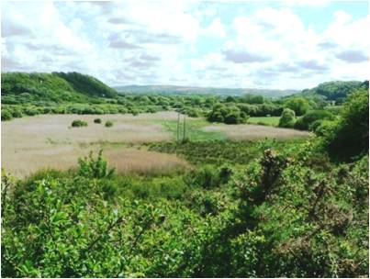
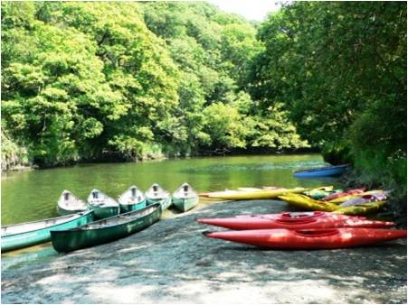
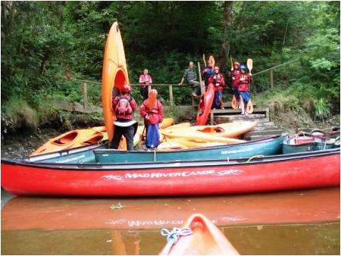
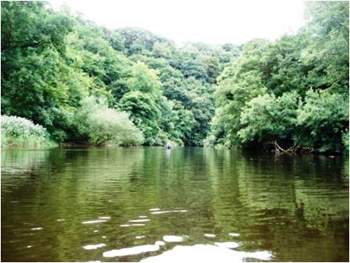
The Welsh Wildlife Centre is situated in the
Teifi Marshes Nature Reserve, between Cardigan and Cilgerran.
The calmer waters of the Teifi offer more
gentle canoeing here. Scenic walks and the
bird viewing hides attract lots of tourists.
Would you rather go bird watching or canoeing?

Slide 8
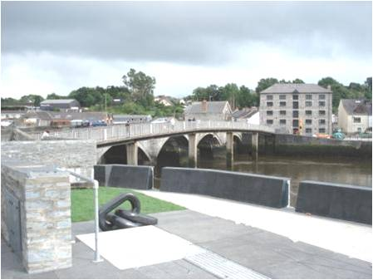
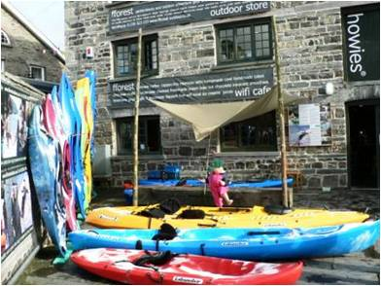
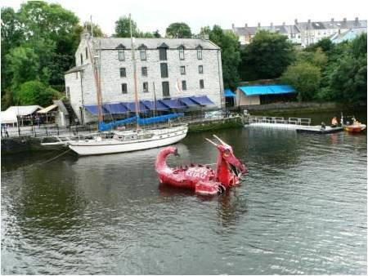
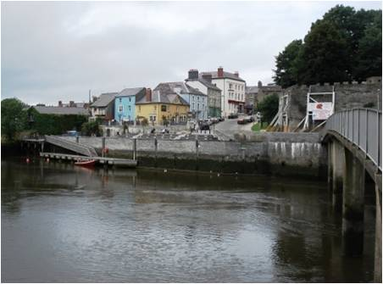
Aberteifi or Cardigan
The Teifi’s journey is nearly over at Cardigan, a bustling town which lies between the sea and the start of the Teifi valley.
Why is there a dragon in the river?

Slide 9
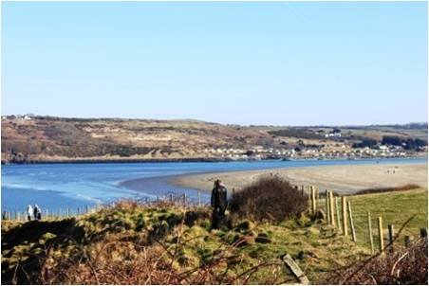
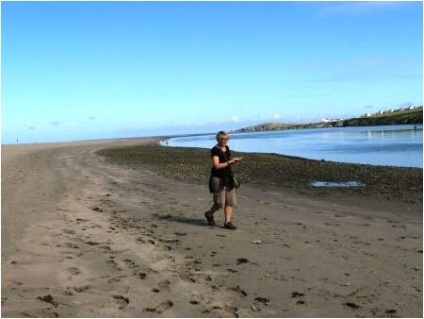
Teifi Mouth: Poppit Sands
We’ve reached the sea!
Most of the sand and mud of the Teifi estuary is covered over with the high tide but when the tide ebbs look how much sand there is!
What’s been your favourite part of the river journey?
By the way – the dragon was made as part of the River Festival celebrations

