Slide 1
Channel Form and Change

Slide 2
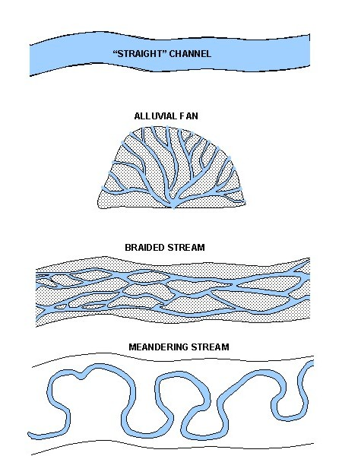
Channel Forms
“Straight” does not mean as if drawn along a ruler. Long straight sections are rare in nature.
“Braids” can be washed away in floods but can be stabilised by vegetation to become permanent islands.

Slide 3
Sinuosity
Few channels are actually straight.
Sinuosity is a measure of how far away a channel is from straight.
channel length
Sinuosity =
straight-line distance
“Meandering” requires the answer to be greater than 1.5

Slide 4
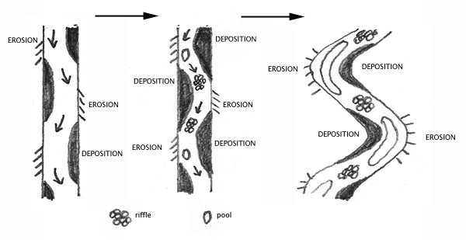
Meander Formation
As water moves through the channel, zones of deeper water, faster flow, and erosion form on one side. A concave bank is produced, the specific shape varying according to material. While erosion takes place on concave banks, deposition takes place on convex banks. While width remains similar the channel moves sideways to become more sinuous.

Slide 5
Meandering:
A common pattern.
Found in streams of all sizes.
Found at all heights.
Can occur anywhere along the stream course.
Is not related to any special conditions.
But-
Very common on moderate gradients.
More frequent where finer material is the dominant load.

Slide 6
Erosion and Deposition
.
The greatest erosion takes place a little downstream of the head of a meander because water flow does not perfectly replicate meander shape.
As a result of this erosion pattern, meanders move downstream(migration).
Meanders can also change shape (mutation).

Slide 7
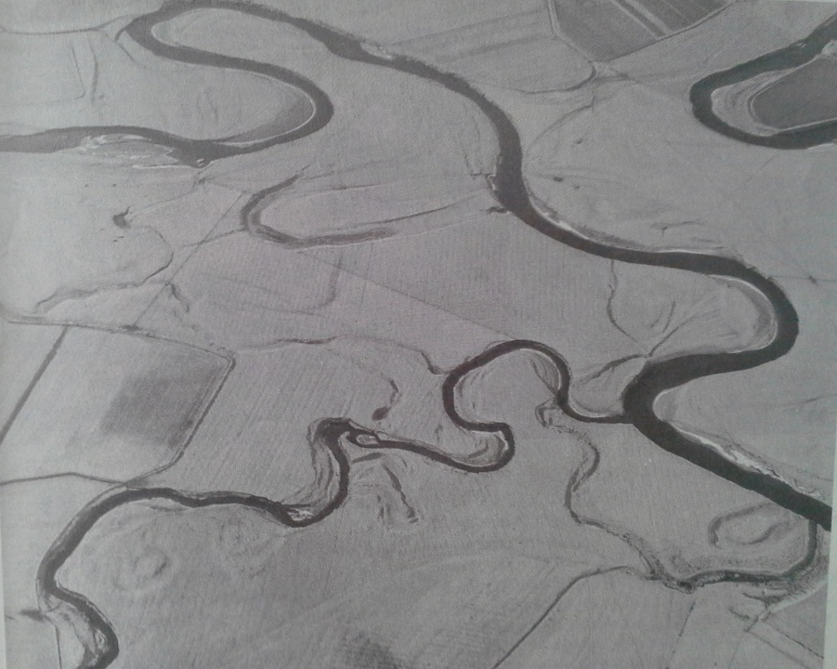
Aerial photo of the River Clyde, Scotland showing meanders that have migrated and mutated and been cut off.
Cross-section of a single meander showing erosion and deposition over seven years.

Slide 8
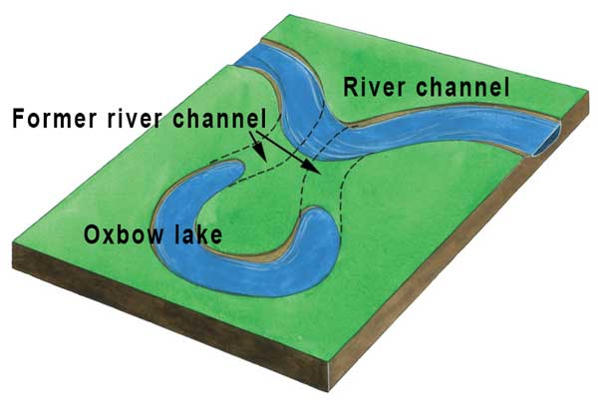
Meander Cut-Off
In very wet periods and floods, the meander loop and straightened channel will carry water. The neck will take a very long time to become dry (abandoned).

Slide 9
Human Interference
Human change to river channels is not a new phenomenon and is extensive.
Main forms:
Straightening.
Diversion both above and below ground.
Creating additional channels.
Key Motive:
To speed up movement of water to prevent flooding.

