Slide 1

Identifying Changes to
Coastal Spits

Slide 2
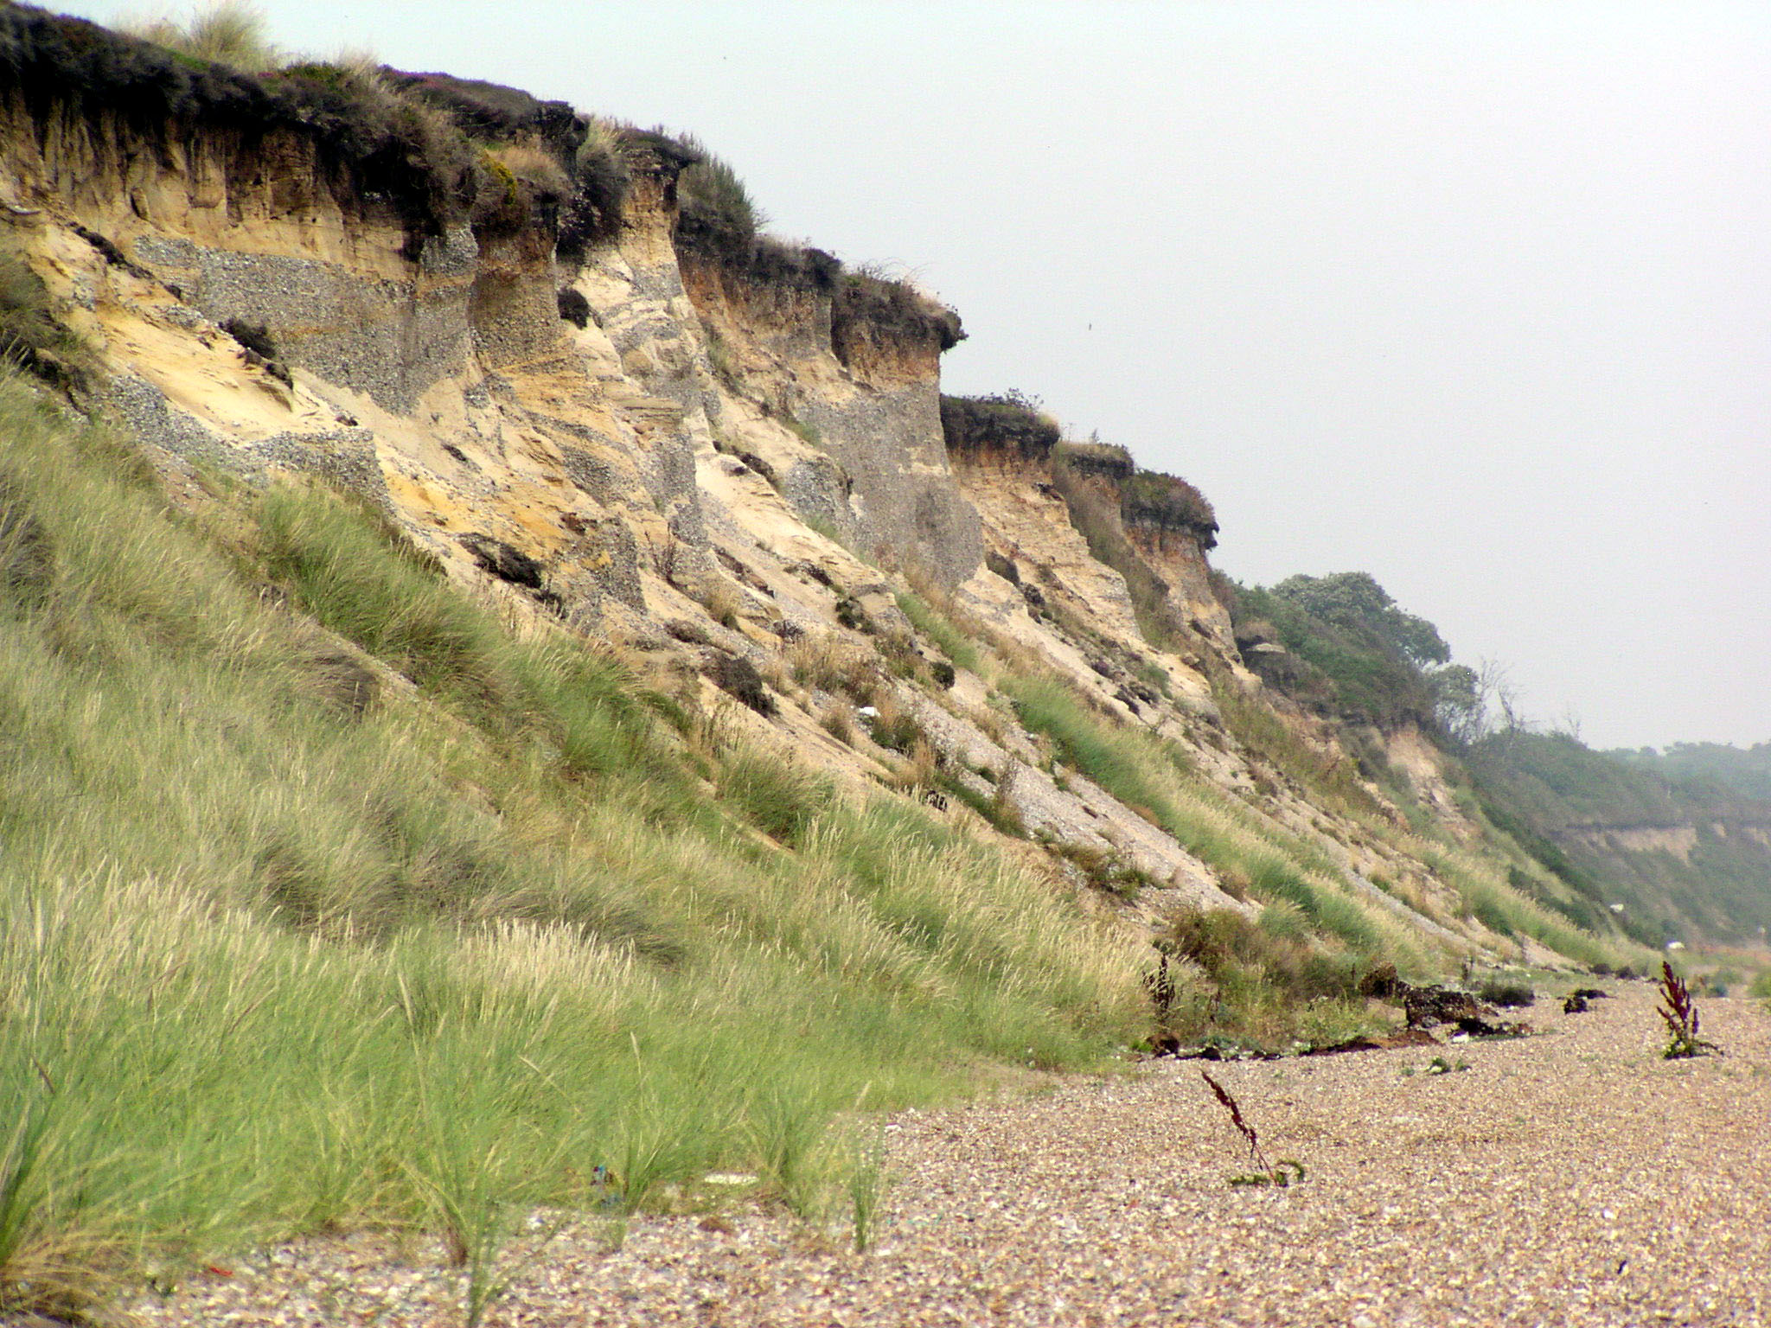
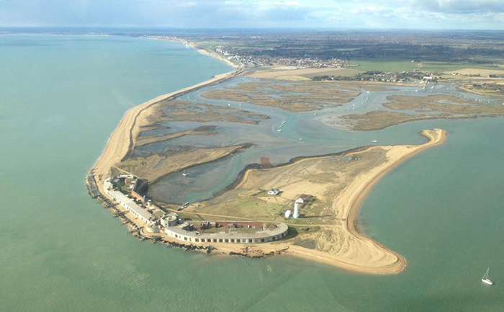
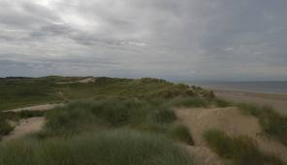
Identify Dynamic Coastal Features
1
4
2
3
Cliff
Beach
Dunes
Spit

Slide 3
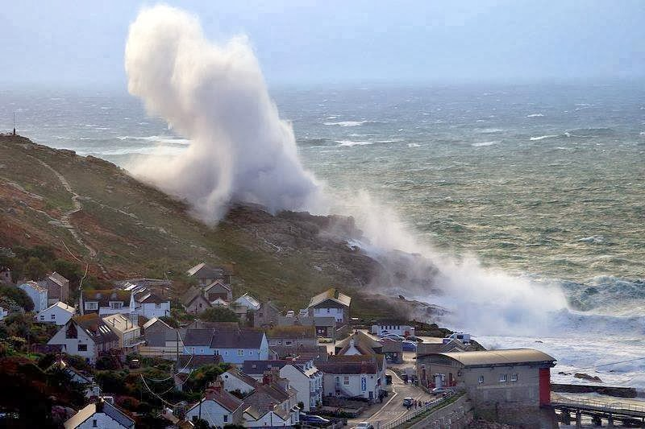
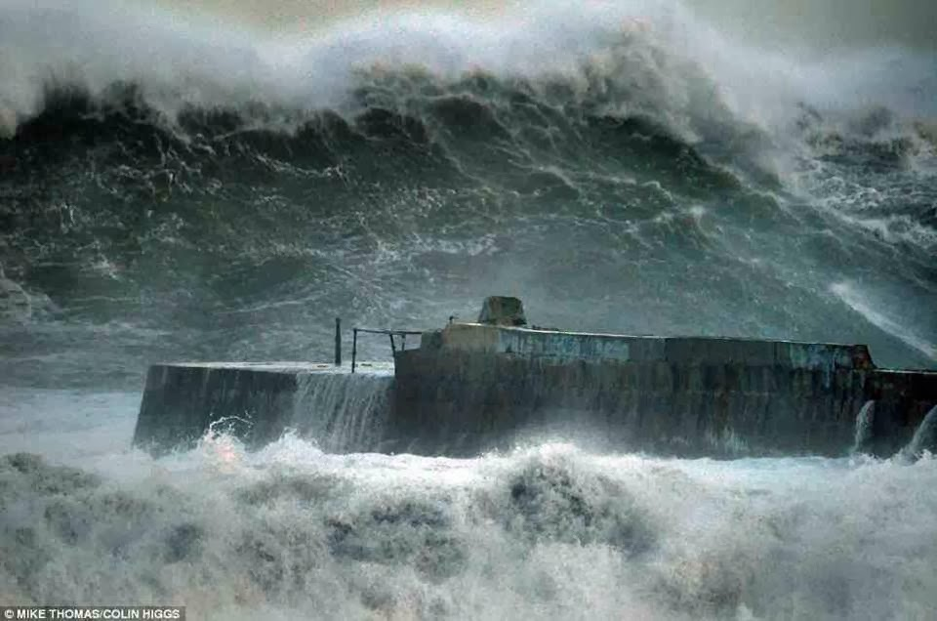

Weather Impact
The winter of 2013-14 had exceptional storms. The media showed both the storms and the impacts. Coastal landforms are modified under these conditions.
Some of the reported effects:

Slide 4
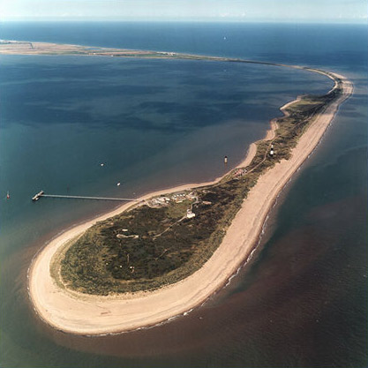
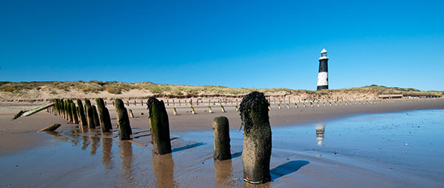
Spurn Point (i)
A spit on the east coast of England, stretching across the mouth of the Humber. It is composed of a series of sand and shingle banks.
The spit is under attack from the strong waves and winds off the North Sea.

Slide 5
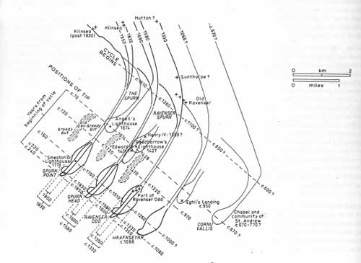
Spurn Point (ii)
Spurn Point has changed size and shape though history.
Notice that the end has been detached (a breach) a number of times.

