Slide 1
My Top Tourism Trail
An example of a leaflet guide to a favourite location.

Slide 2
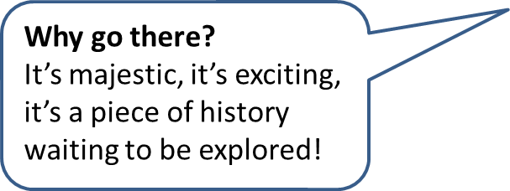
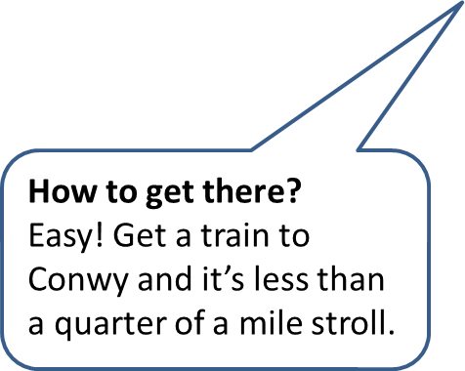
Top Places to visit in Llandudno and Conwy: No1. Conwy Castle
Where is it?
In Conwy walled town, Borough of Conwy, overlooking the River Conwy estuary in North Wales.
Star Rating

