Slide 1
Ideas for #Homeschooling with Digimap for Schools
Darren Bailey
Education Manager
Ordnance Survey

Slide 2
Next 30 mins; Three ideas using Digimap
Fauna and Continents (continents)
What time is it? (Time zones, locating countries/continents, and Maths!)
Map Skills (Symbols, Grid Refs, Direction and Distance)
Who’s got the nosiest Street? (Field work, collecting data and digital technologies)
Questions at the end

Slide 3
Fauna and Continents;
14 pictures of Animals, can you pin them to their native continent.
Locating places and continents.

Slide 4
Armadillo – South America | Cabybara – South America
Grizzly Bear – North America | Kangeroo - Australasia
Lion - Africa | Koala - Australasia
Narwhal - Artic | Panda - Asia
Racoon – North America | Rhino - Africa
Tiger - Asia | Wild Boar - Europe
Reindeer - Europe | Emperor Penguin - Antarctica

Slide 5
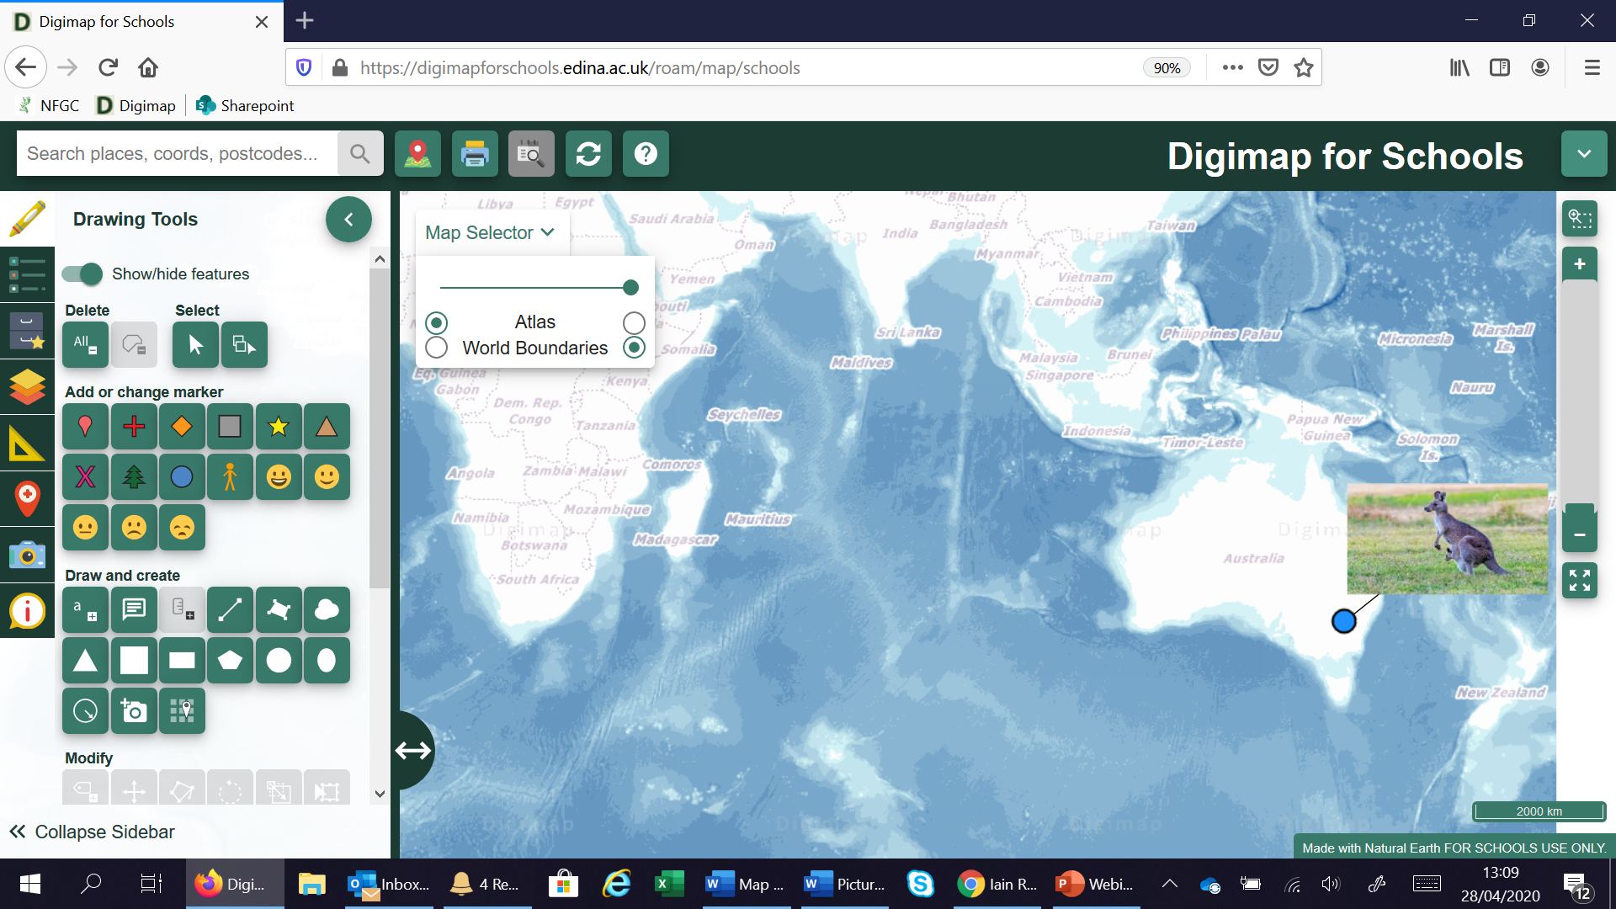


Slide 6
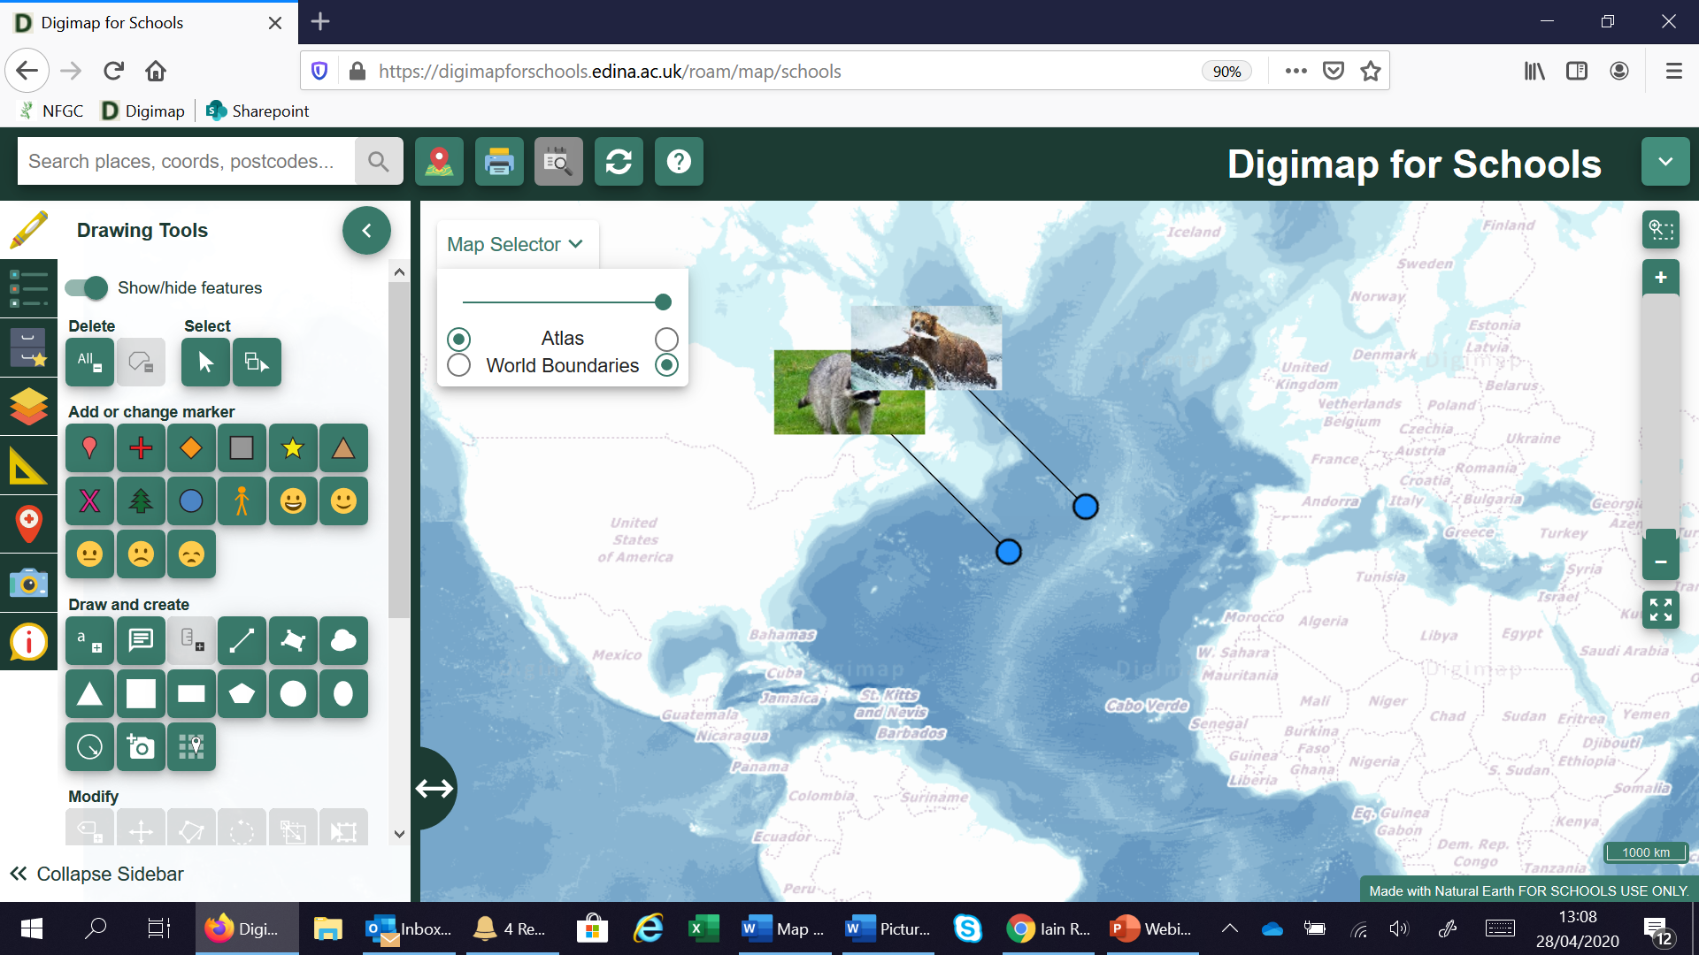

Slide 7
What time is it?
Using the time zone layer, can we work out the times in different places.
You can start with easy ones and get progressively harder. Covers; place, location, time zones and maths!
Extra; measure the distance between places.

Slide 9
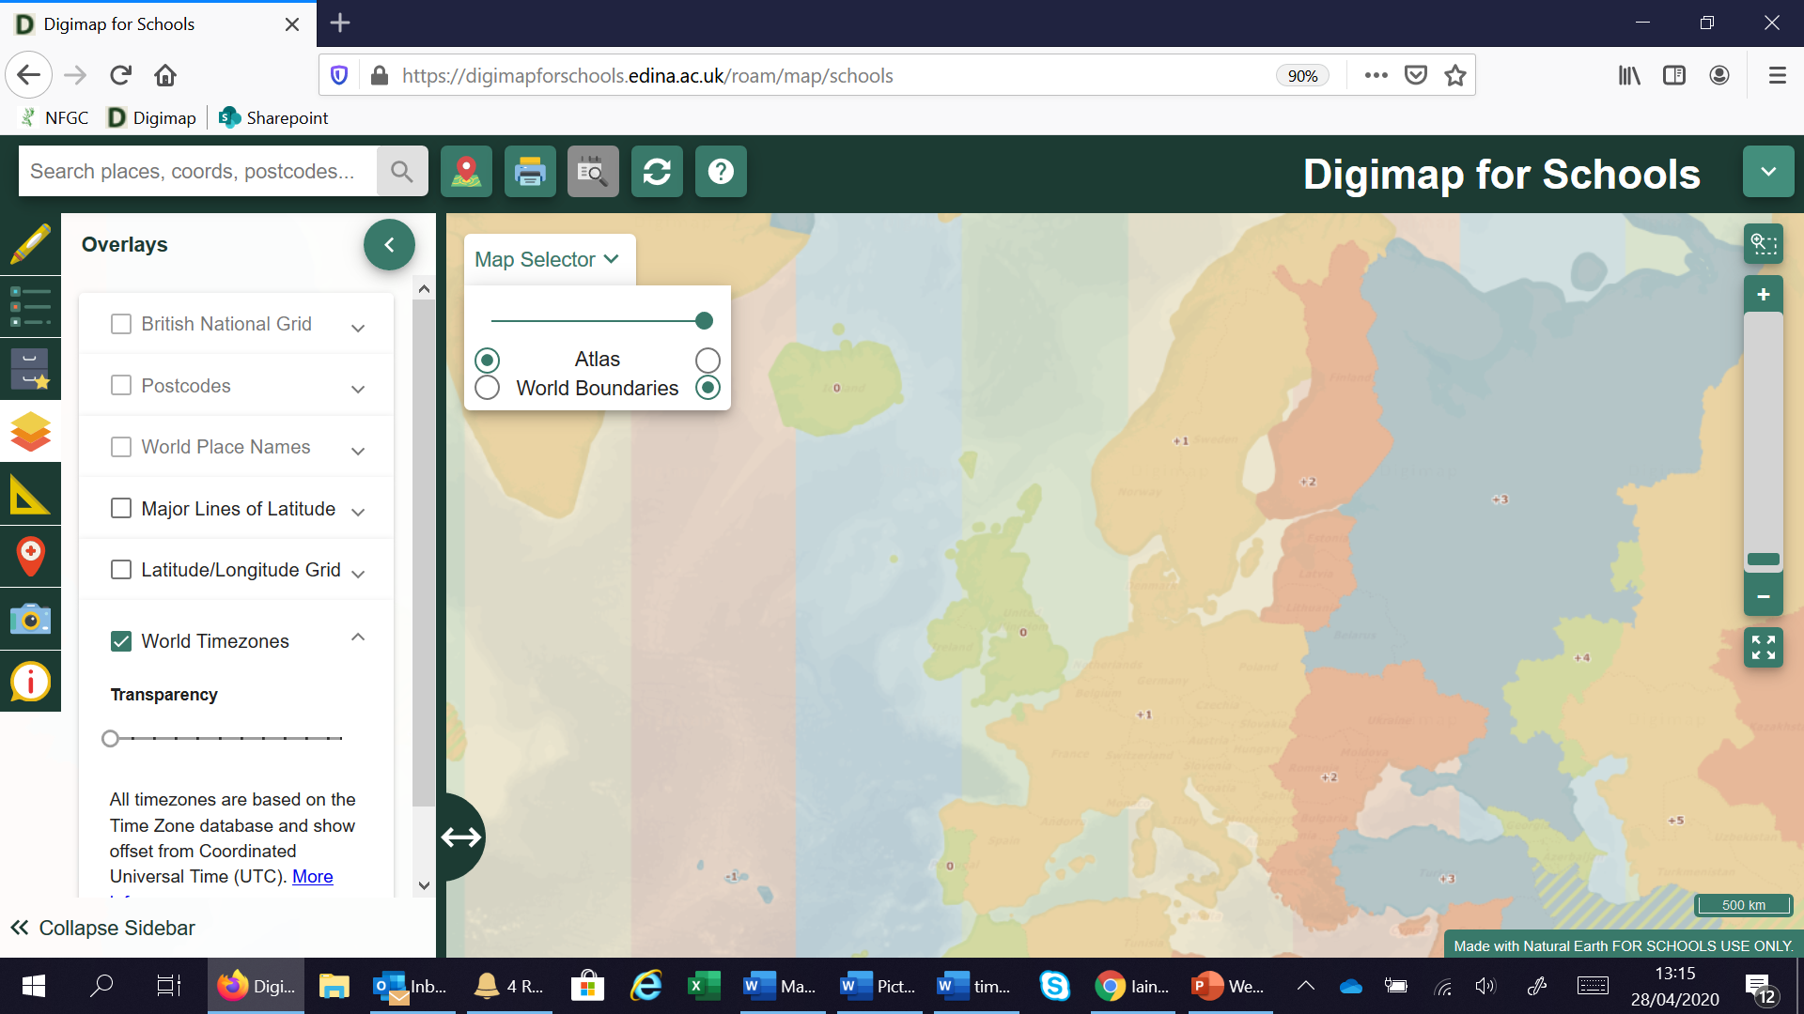


Slide 10
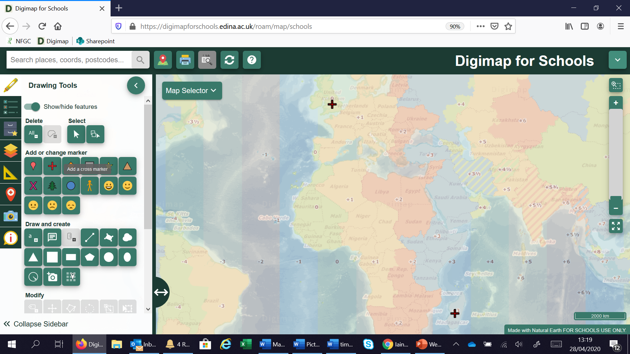

Slide 11
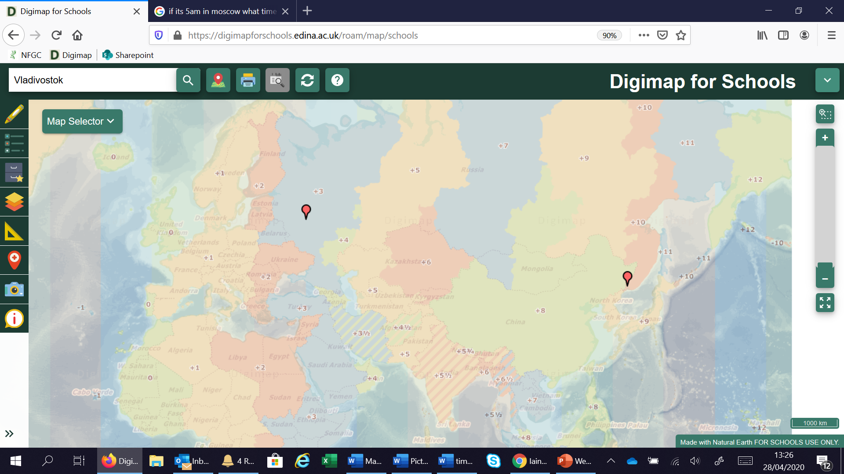

Slide 12
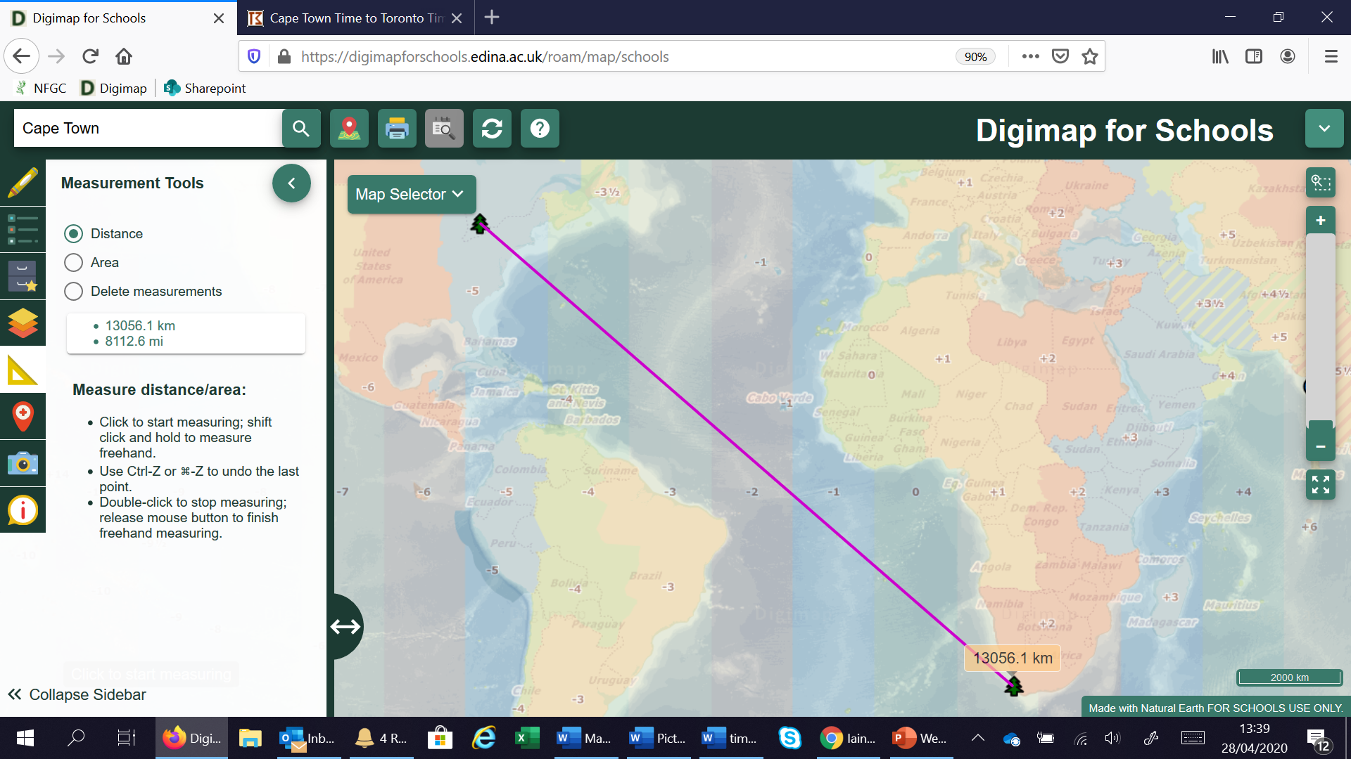

Slide 13
Map Skills;
Symbols, 4/6 figure Grid references, Direction and Distance
3 ways to use the map;
Print
On screen in Digimap For Schools
Or Open it in Adobe and zoom in
Map will be added to the resources list

Slide 14
You will be using a 1:25 000 map of the New Forest. You will need to find symbols, use 4 & 6 figure grid references and work out direction and scale. A 1:25 000 map has a scale of 4cm to 1km

Slide 15
Who’s got the noisiest street?
Using location and decibel apps, where is the nosiest place
Fieldwork, place and collecting data

Slide 16
You will need;
A smart phone
Two apps; Decibel X and either Gridpoint GB (iphone) or OS Locate (Android)
Excel to record your data.

Slide 17
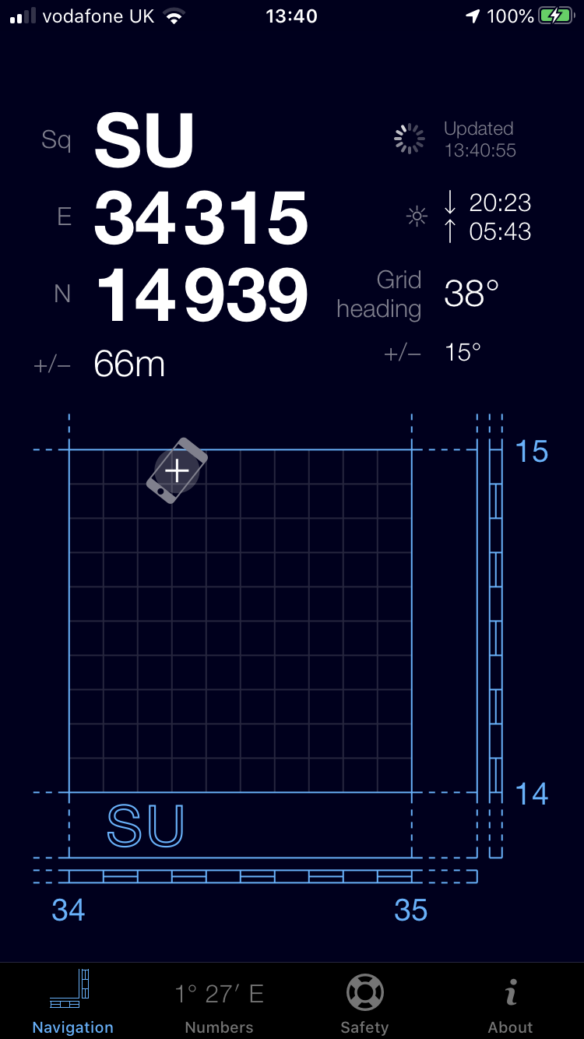
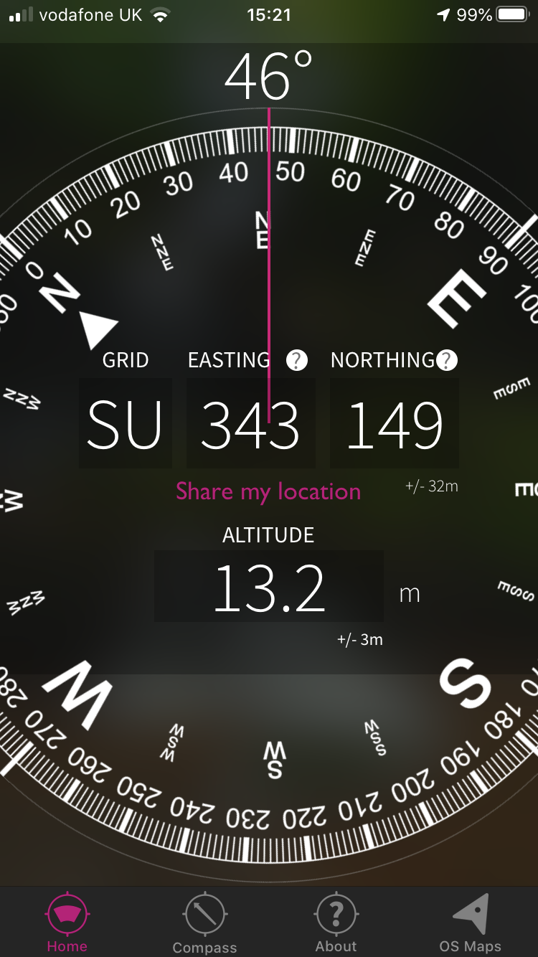
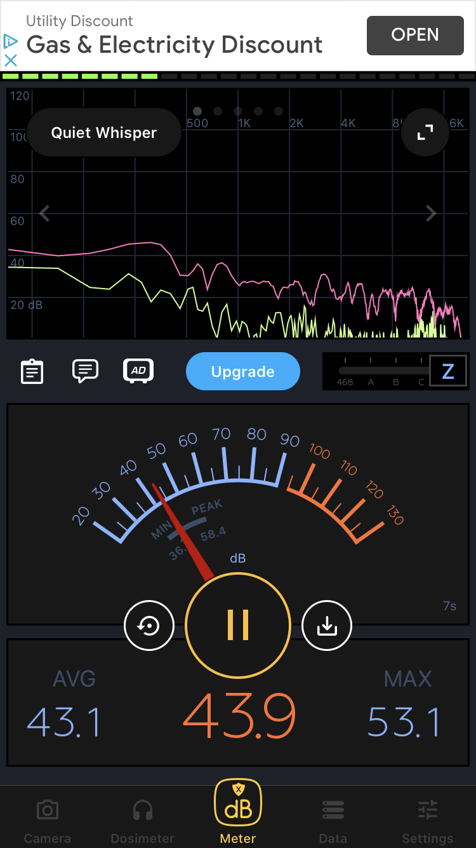
Gridpoint GB
OS Locate
Decibel X

Slide 18
Each pupil will record their location using Gridpoint GB or OS Locate
And the decibel level
By taking a screen shot of each one, they record both pieces of data
You can collate all the data together in a spreadsheet and upload it in to Digimap for Schools

Slide 19
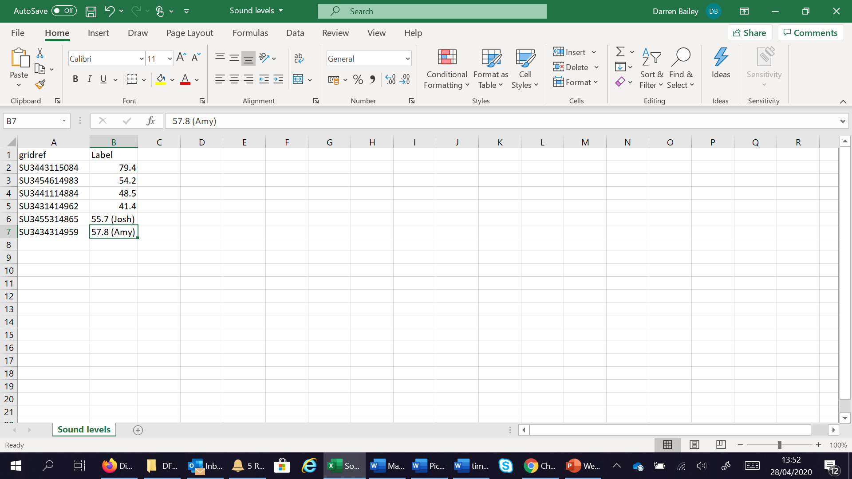

Slide 20

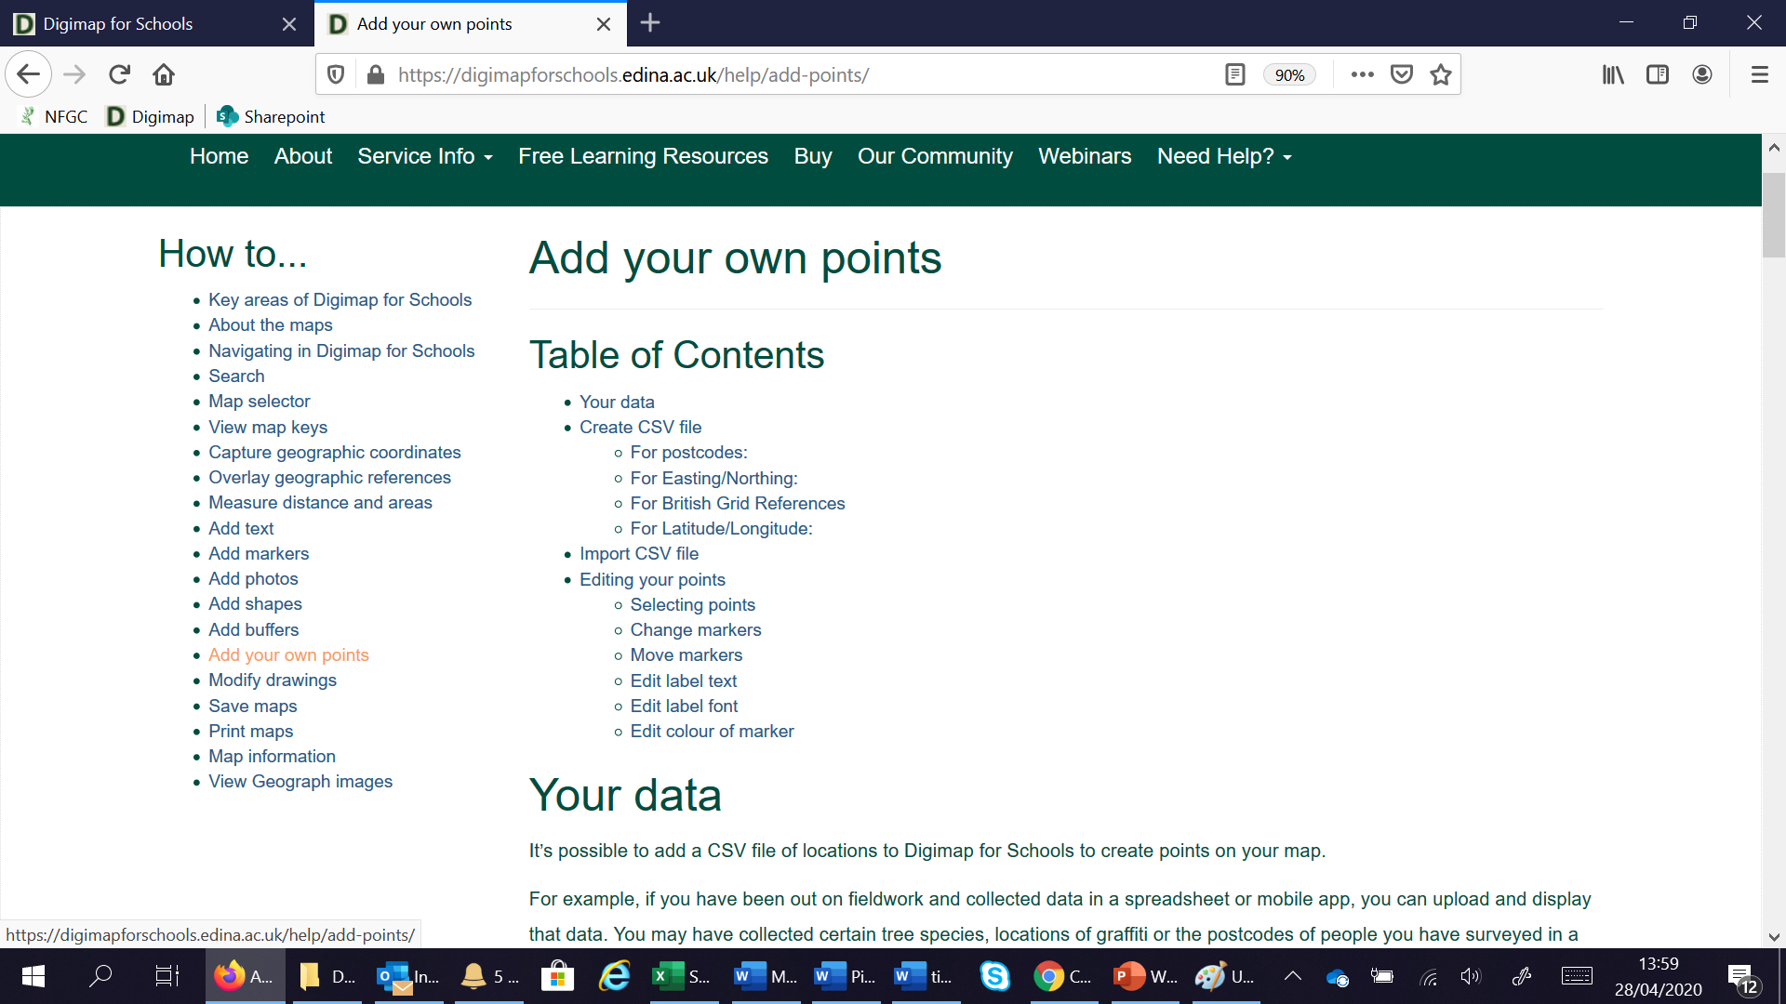

IMPORTANT INFORMATION!
Format of location field– Click the ? for the help files
Your spreadsheet must be saved as .CSV file

Slide 21
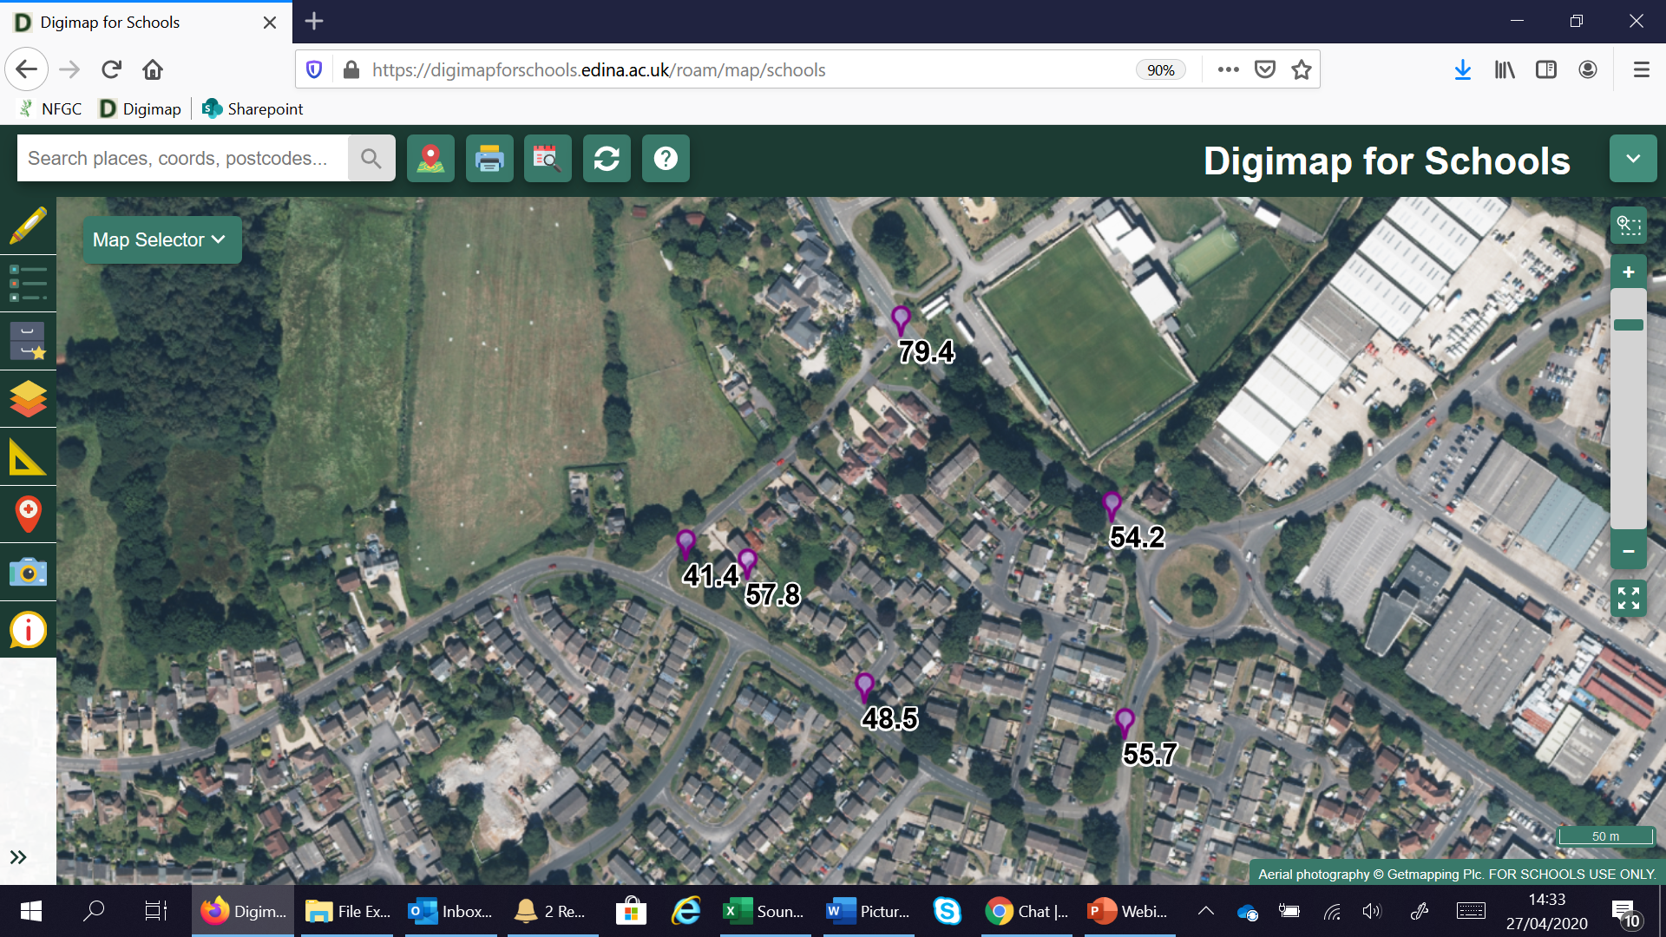

Slide 22
Other things you could record (could be around the school site);
Temperature
Wind Speed
Rain fall
Height

Slide 23
Questions?

